Slide 1





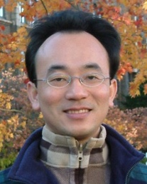



AI技術在永續議題下的應用 (AI Technology Applications in Sustainability)
工研院 產業學院 綠能所
Time: 2025/9/22 (一) 13:30-16:30
Place: 21館200-2, 新竹縣竹東鎮中興路4段195號21館
Host: 薛雅寧, 工業技術研究院 產業學院 策略及跨域訓練部
University Ambassador
戴敏育 教授 (Prof. Min-Yuh Day)
國立臺北大學 資訊管理研究所 所長
金融科技暨綠色金融研究中心 主任
Certified Instructor
https://web.ntpu.edu.tw/~myday

Slide 2











戴敏育 教授 Prof. Min-Yuh Day
University Ambassador
Certified Instructor
Director, Information Management, NTPU
Director, Intelligent Financial Innovation Technology, IFIT Lab, IM, NTPU
Director, Fintech and Green Finance Center (FGFC), NTPU
Division Director, Sustainable Development, Sustainability Office, NTPU
Visiting Scholar, IIS, Academia Sinica
Ph.D., Information Management, NTU
Artificial Intelligence, Agentic AI, ESG and Green Financial Technology, Big Data Analytics, Electronic Commerce

Slide 3
Outline
1. 永續AI導入介紹 (Introduction to Sustainable AI)
2. AI在智慧能源管理的應用 (AI in Smart Energy Management)
3. AI在氣候變遷與環境監測的應用 (AI in Climate Change and Environmental Monitoring)
4. AI在循環經濟的應用案例 (AI in the Circular Economy)
5. AI永續技術專案小組討論與應用構想設計 (Sustainable AI Project Team Discussion and Application Design)
6. 綜合討論 (Open Discussion)

Slide 4


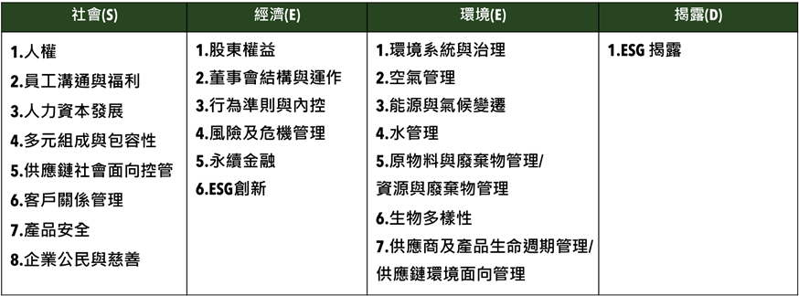
衡量企業永續關鍵指標 臺北大學獨創ESG永續評鑑系統
Source: https://www.aacsb.ntpu.edu.tw/twsvi/view.php?id=Nzc=

Slide 5







台灣永續評鑑
國立臺北大學商學院企業永續發展研究團隊

Slide 6
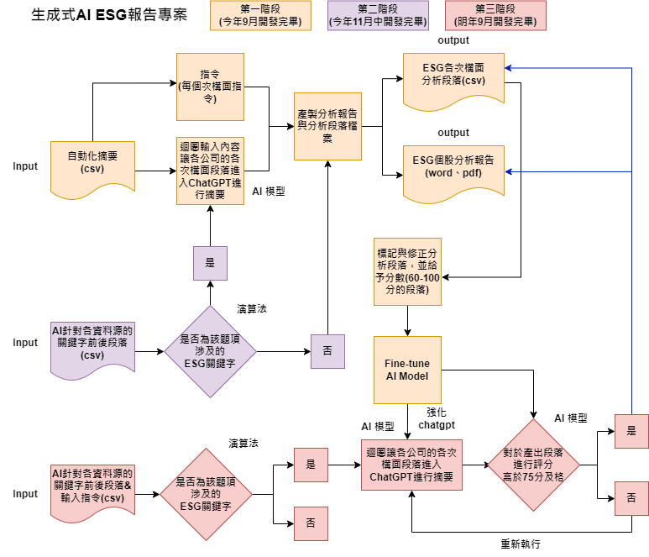
透過 AI SEED 提升評鑑效率
為使評鑑效率提升，與國立臺北大學資管所及資工所合作，開發相關程式， 已有25%題項自動或半自動化，大幅提升評鑑效率，並持續開發機械學習，持續透過AI 輔助評鑑進行。
另也透過AI SEED團隊持續將部分流程自動化，提升評鑑正確性，減少人力出錯可能。
題號 | 題目關鍵字 | 完成度
2-1-15 | 僅分派董監酬勞未分派股利 | 100%
2-2-3 | 獨董達董事席次1/2以上 | 100%
2-2-4 | 至少兩名獨董任期不超過9年 | 100%
2-2-14 | 設提名委員會且半數以上為獨董 | 100%
2-2-30 | 董事長兼任總經理 | 100%
2-2-31 | 1/3以上董事任期超過15年 | 100%
2-3-8 | 破產／面臨下市 | 100%
2-3-15 | 資安長或資訊安全委員會 | 100%
2-4-7 | 無保留意見 | 100%

Slide 7
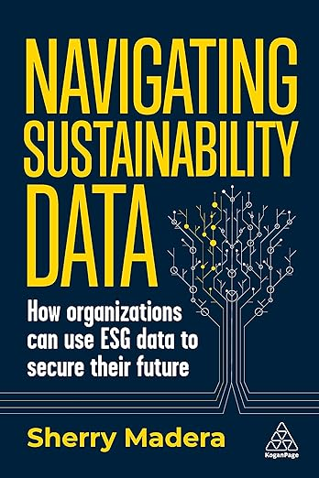
Sherry Madera (2024), Navigating Sustainability Data: How Organizations can use ESG Data to Secure Their Future, Kogan Page
Source: https://www.amazon.com/Navigating-Sustainability-Data-Organizations-Secure/dp/1398612243/

Slide 8
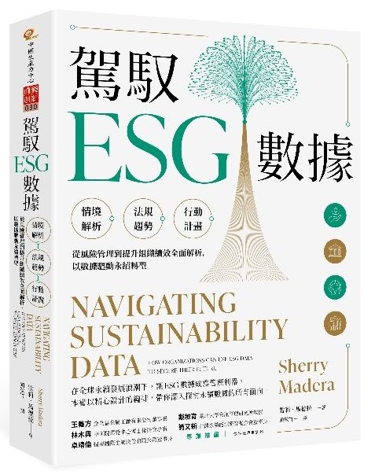
雪莉．馬德拉 (Sherry Madera) (顏敏竹 譯) (2024), 駕馭ESG數據 (Navigating Sustainability Data), 財團法人中國生產力中心
專業推薦：
王義方 （金全益金屬工廠有限公司董事長）
林木興 （中研院環變中心博士後研究學者）
卓靖倫 （揚秦國際企業股份有限公司董事長）
戴敏育 （國立臺北大學資訊管理研究所教授）
簡又新 （台灣永續能源研究基金會董事長）
Source: https://www.eslite.com/product/10012011762682688929002

Slide 9


Innovative Agentic AI Technology for Autonomous ESG Report Generation Industrial Technology Research Institute (ITRI), Fintech and Green Finance Center (FGFC, NTPU), NTPU-114A513E01, 2025/03/01~2025/12/31

Slide 10
Generative AI-Driven ESG Report Generation Technology Industrial Technology Research Institute (ITRI), Fintech and Green Finance Center (FGFC, NTPU), NTPU-113A513E01, 2024/03/01~2024/12/31

Slide 11
AI Technology Applications in Sustainability
1. 永續AI導入介紹 (Introduction to Sustainable AI)
2. AI在智慧能源管理的應用 (AI in Smart Energy Management)
3. AI在氣候變遷與環境監測的應用 (AI in Climate Change and Environmental Monitoring)
4. AI在循環經濟的應用案例 (AI in the Circular Economy)
5. AI永續技術專案小組討論與應用構想設計 (Sustainable AI Project Team Discussion and Application Design)
6. 綜合討論 (Open Discussion)

Slide 12
Generative AI Powering Digital Sustainability Transformation

Slide 13
Agentic AI for ESG Applications

Slide 14
Generative AI, Agentic AI, Physical AI
Physical AI
Self-driving cars
General robotics
Agentic AI
Coding assistants
Customer service
Patient care
Generative AI
Digital marketing
Content creation
Perception AI
Speech recognition
Deep recommender systems
Medical imaging
2012 AlexNet
Deep learning breakthrough
Source: NVIDIA (2025), GTC March 2025 Keynote with NVIDIA CEO Jensen Huang, https://www.youtube.com/watch?v=_waPvOwL9Z8

Slide 15
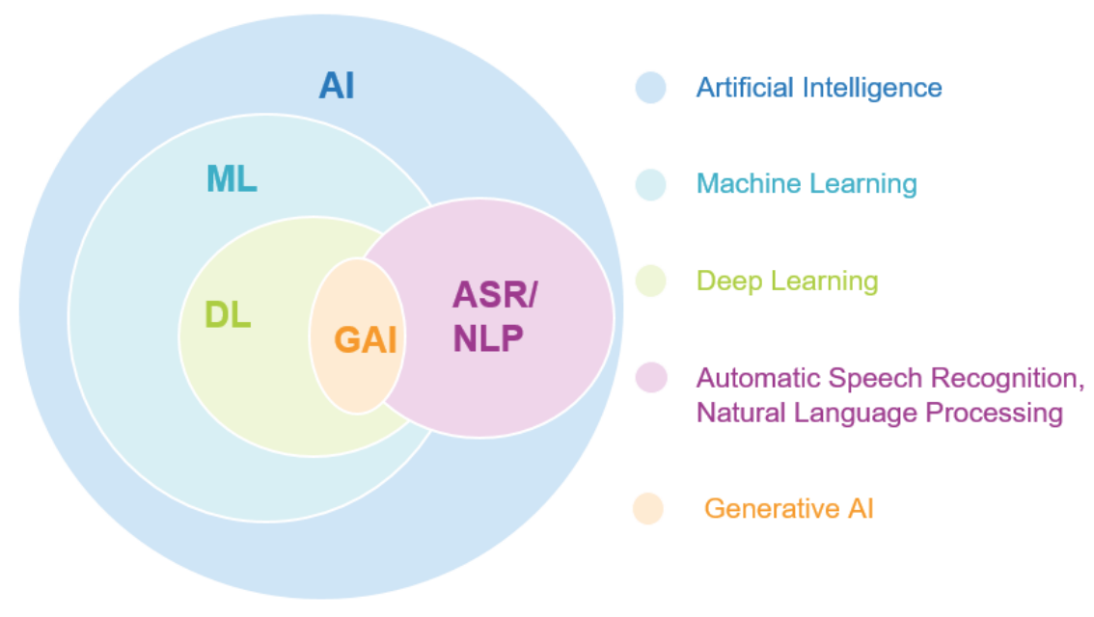
AI, ML, DL, Generative AI
Source: Jeong, Cheonsu. "A Study on the Implementation of Generative AI Services Using an Enterprise Data-Based LLM Application Architecture." arXiv preprint arXiv:2309.01105 (2023).

Slide 16
Generative AI
Computing
Generative AI
Data
Algorithms

Slide 17
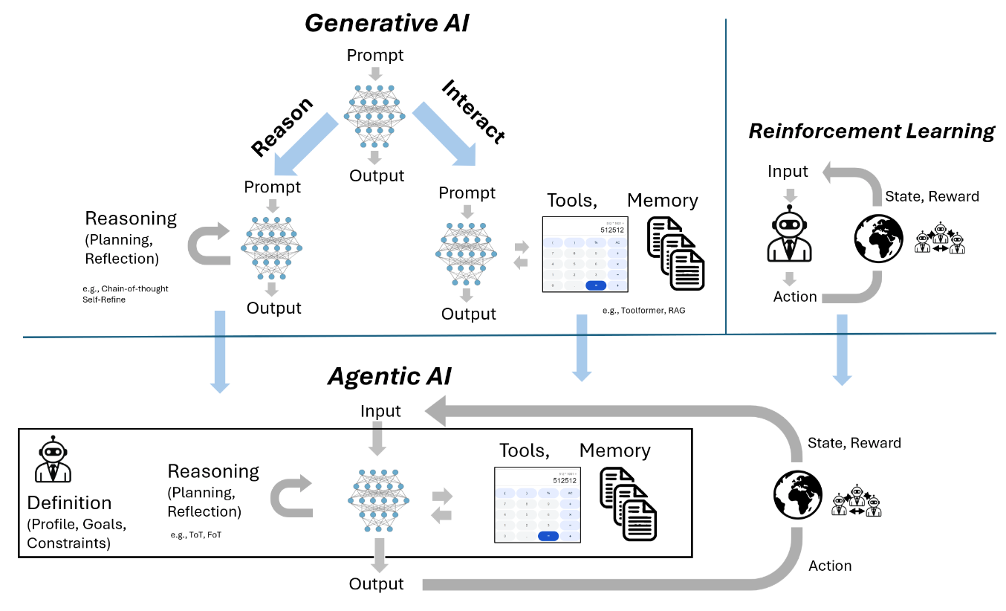
From Generative AI to Agentic AI
Source: Schneider, Johannes. "Generative to Agentic AI: Survey, Conceptualization, and Challenges." arXiv preprint arXiv:2504.18875 (2025).

Slide 18
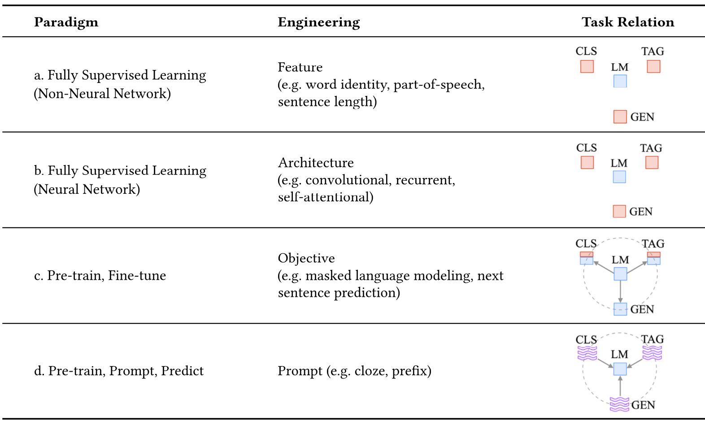
Four Paradigms in NLP (LM)
Transfer Learning: Pre-training, Fine-Tuning (FT)
GAI: Pre-train, Prompt, and Predict (Prompting)
Source: Pengfei Liu, Weizhe Yuan, Jinlan Fu, Zhengbao Jiang, Hiroaki Hayashi, and Graham Neubig. (2023) "Pre-train, prompt, and predict: A systematic survey of prompting methods in natural language processing." ACM Computing Surveys 55, no. 9 (2023): 1-35.

Slide 19
Comparison of Generative AI and Traditional AI
Feature | Generative AI | Traditional AI
Output type | New content | Classification/Prediction
Creativity | High | Low
Interactivity | Usually more natural | Limited

Slide 20
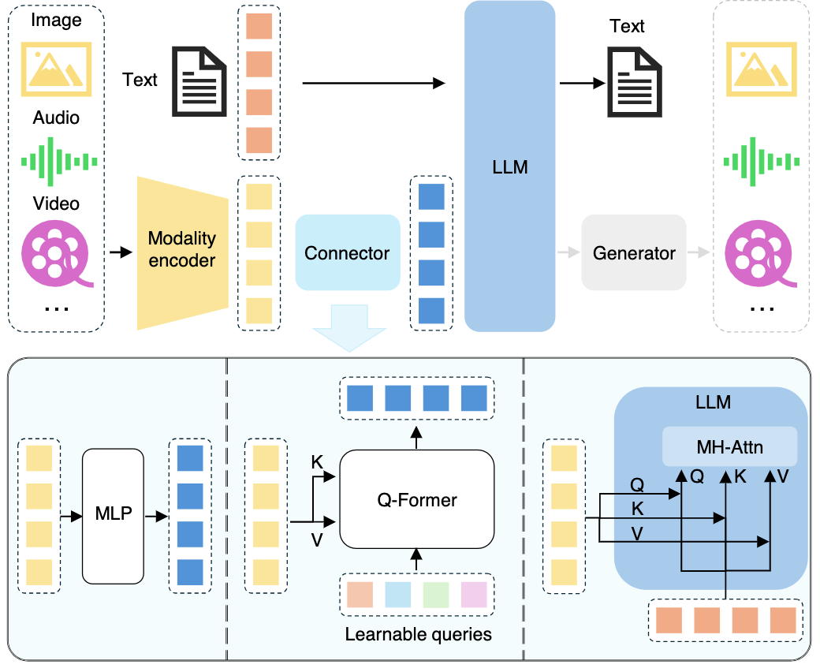
Multimodal Large Language Models (MLLM)
Multimodall LLM Three types of connectors:
1. projection-based
2. query-based
3. fusion-based connectors
Source: Shukang Yin, Chaoyou Fu, Sirui Zhao, Ke Li, Xing Sun, Tong Xu, and Enhong Chen. (2024) "A survey on multimodal large language models." National Science Review (2024): nwae403.

Slide 21
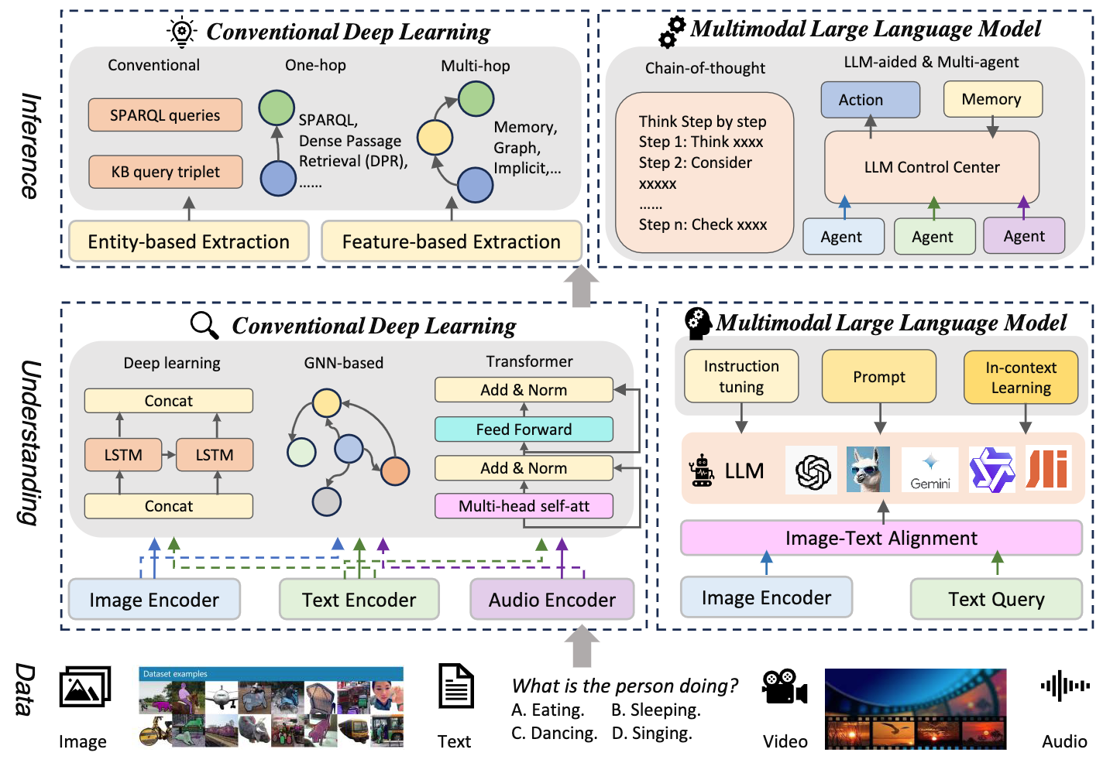
Multimodal Large Language Model (MLLM) for Vision Question Answering
Source: Jiayi Kuang, Jingyou Xie, Haohao Luo, Ronghao Li, Zhe Xu, Xianfeng Cheng, Yinghui Li, Xika Lin, and Ying Shen. (2024) "Natural Language Understanding and Inference with MLLM in Visual Question Answering: A Survey." arXiv preprint arXiv:2411.17558.

Slide 22
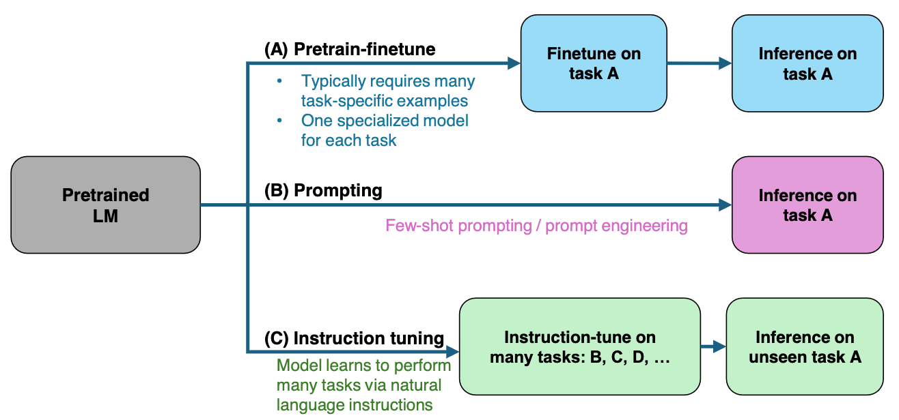
Large Language Models (LLM) Three typical learning paradigms
Source: Shukang Yin, Chaoyou Fu, Sirui Zhao, Ke Li, Xing Sun, Tong Xu, and Enhong Chen. (2024) "A survey on multimodal large language models." National Science Review (2024): nwae403.

Slide 23
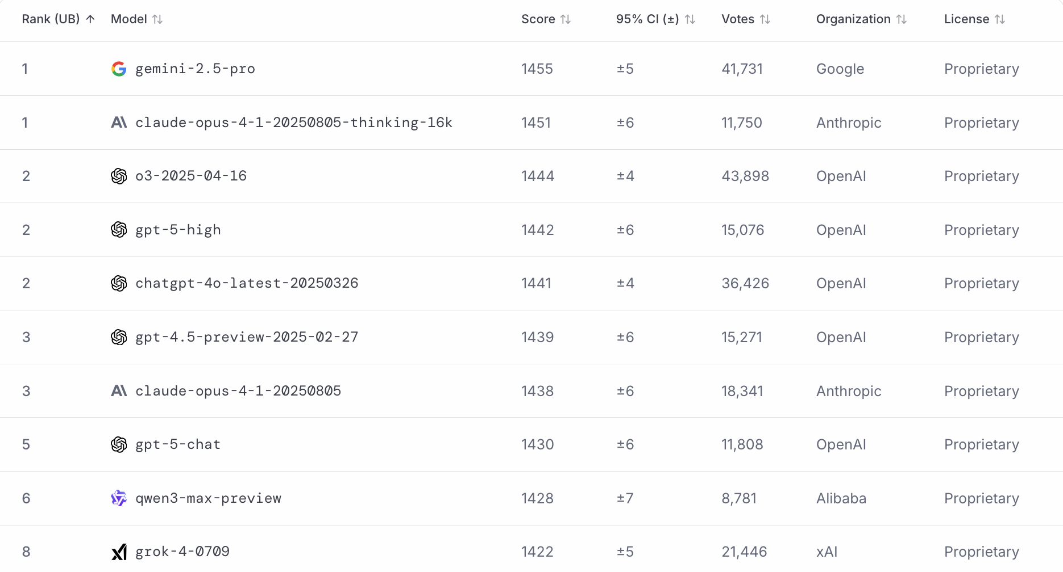
LMArena Leaderboard
https://lmarena.ai/

Slide 24
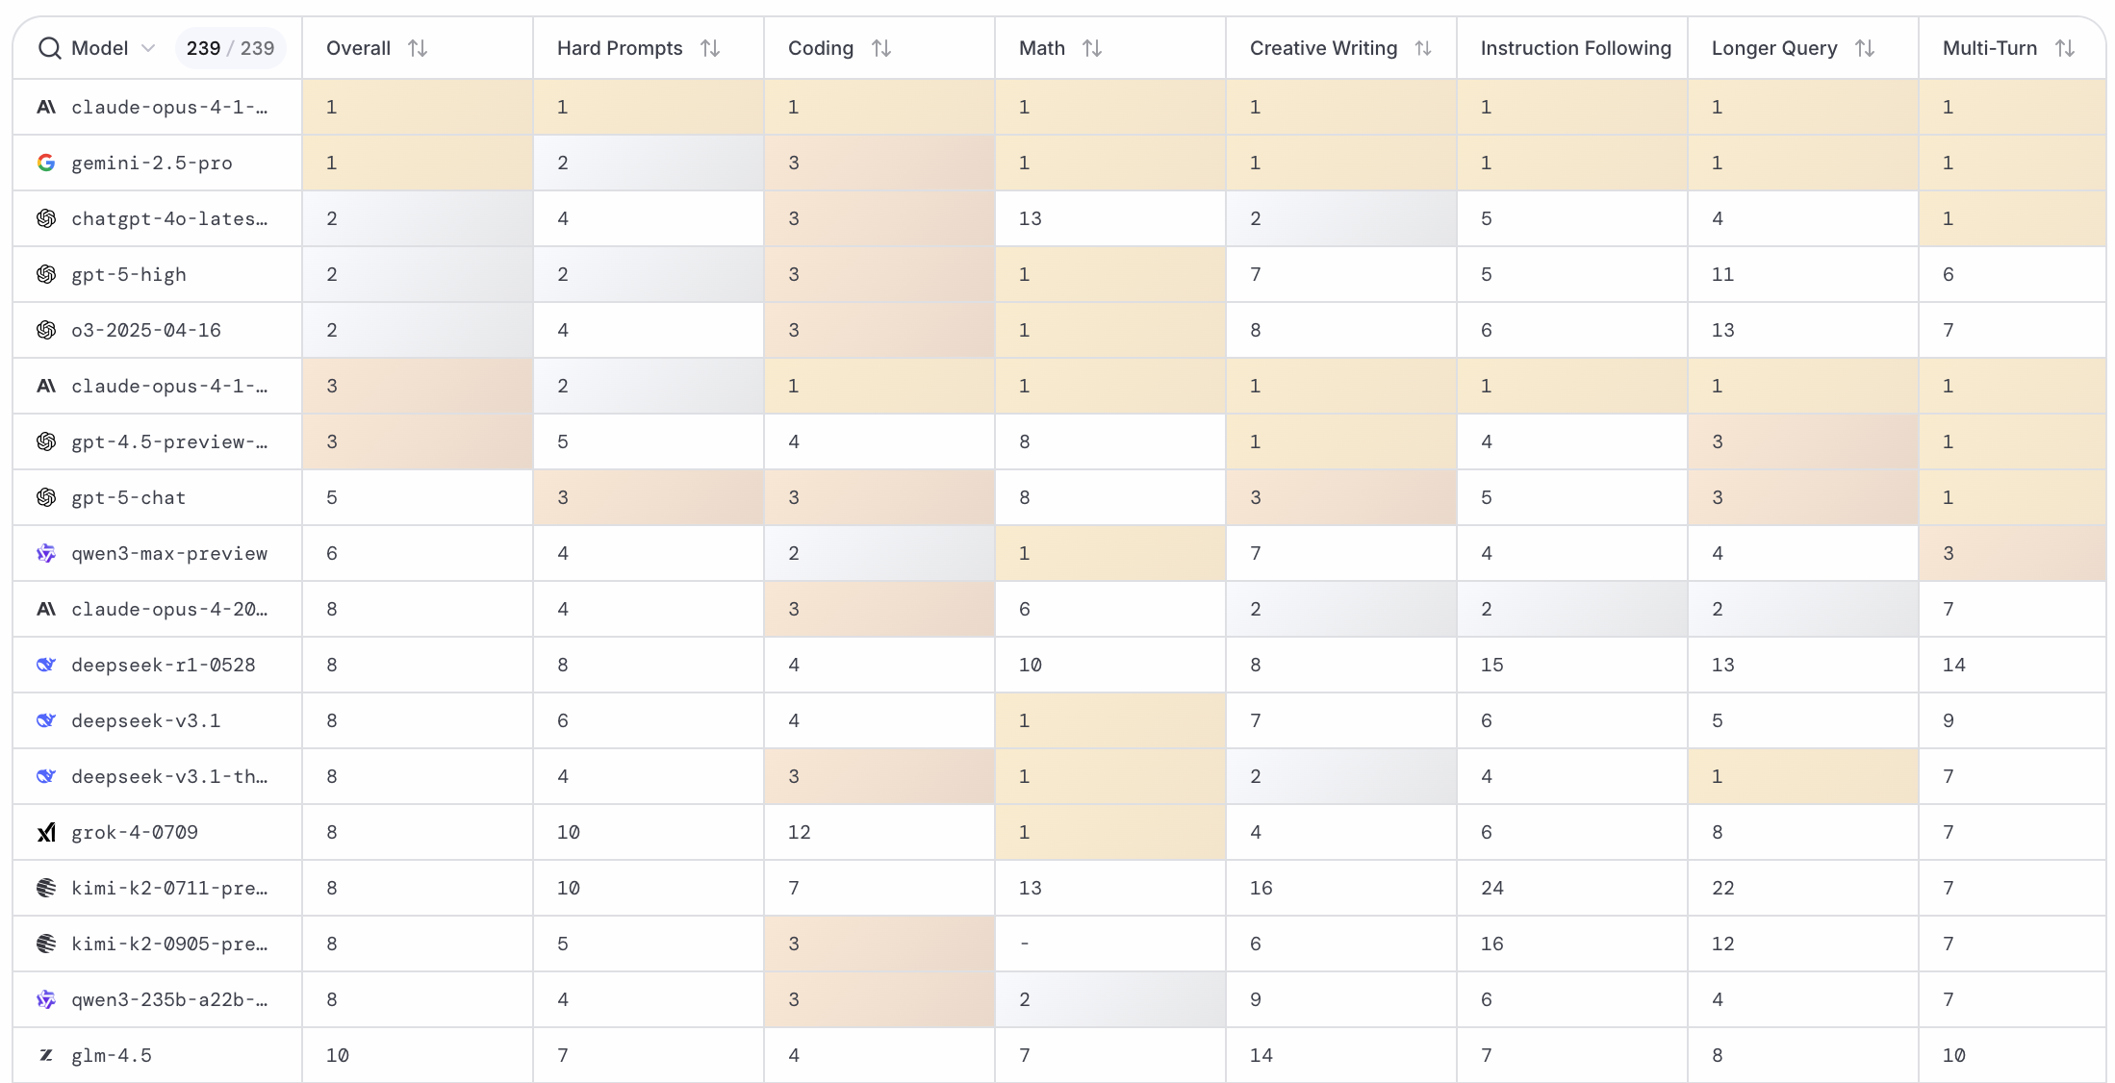
LMArena Leaderboard
https://huggingface.co/spaces/lmarena-ai/lmarena-leaderboard

Slide 25
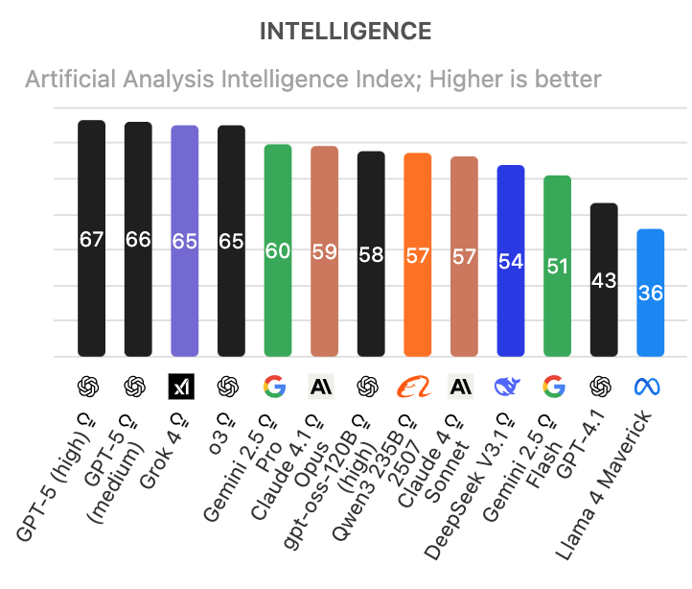
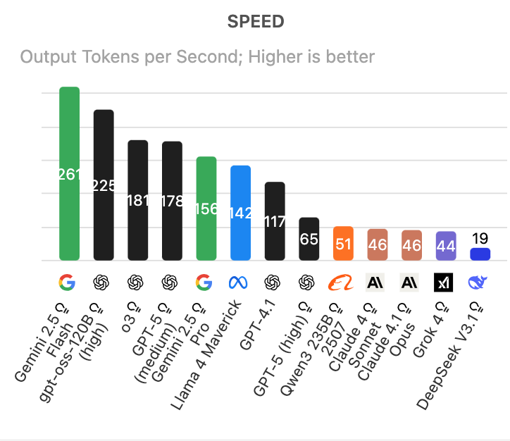
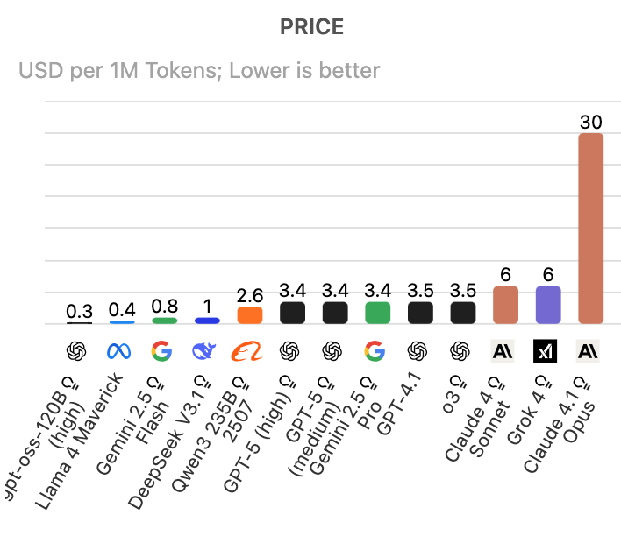
Artificial Analysis Intelligence Index Intelligence, Speed, Price
Source: https://artificialanalysis.ai/

Slide 26
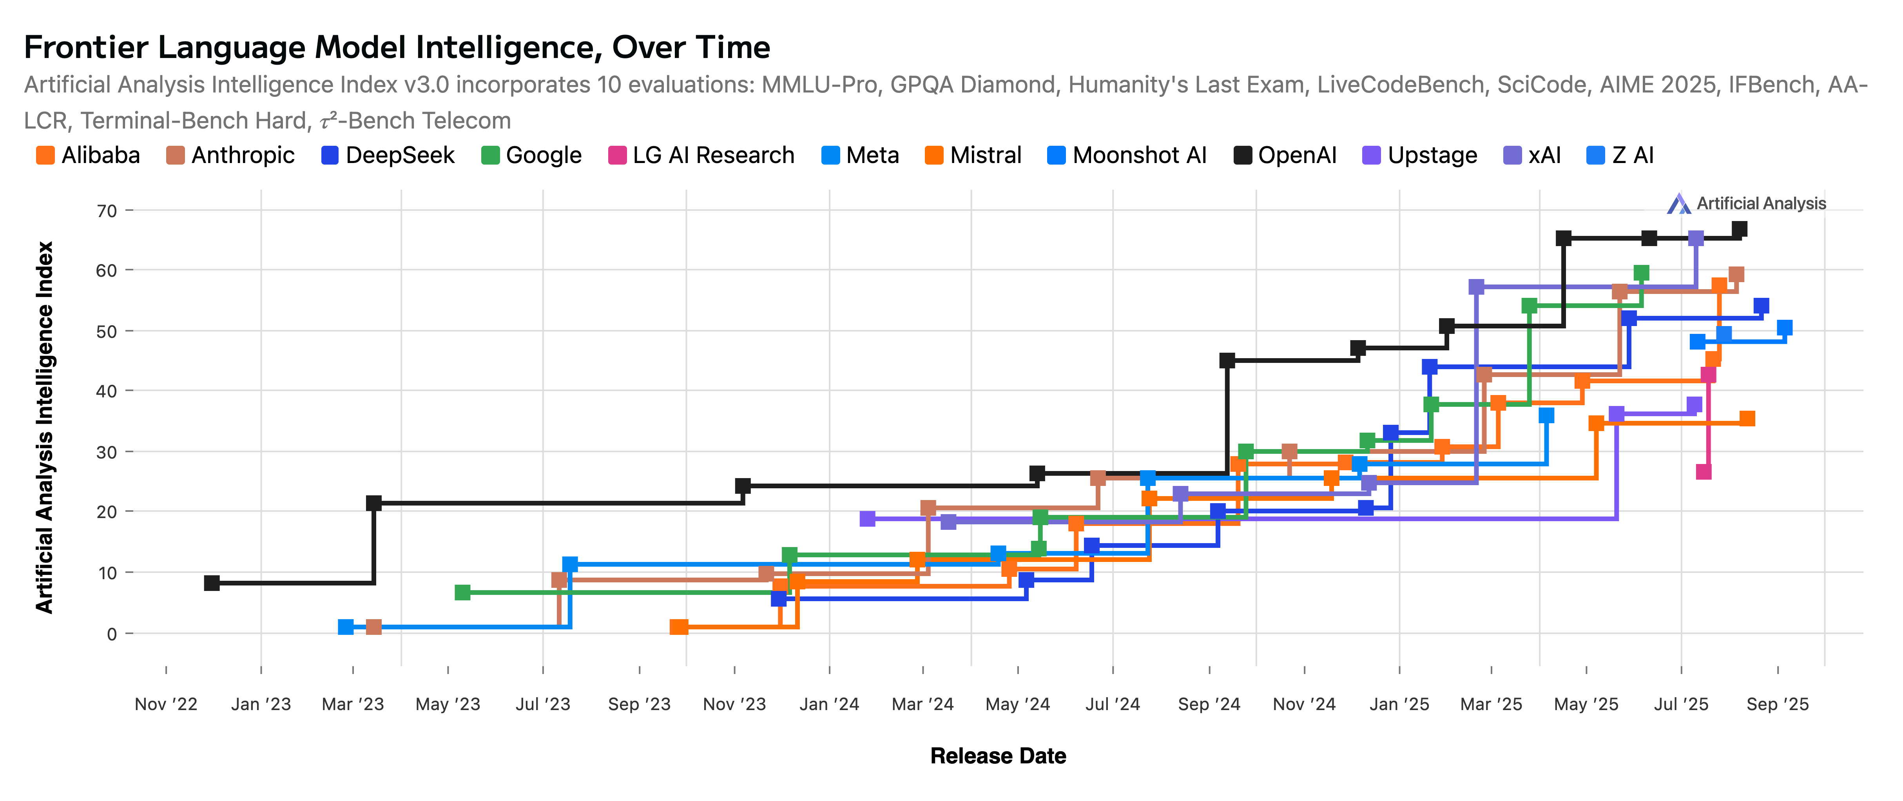
Artificial Analysis Intelligence Index 2022-2025
Source: https://artificialanalysis.ai/

Slide 27
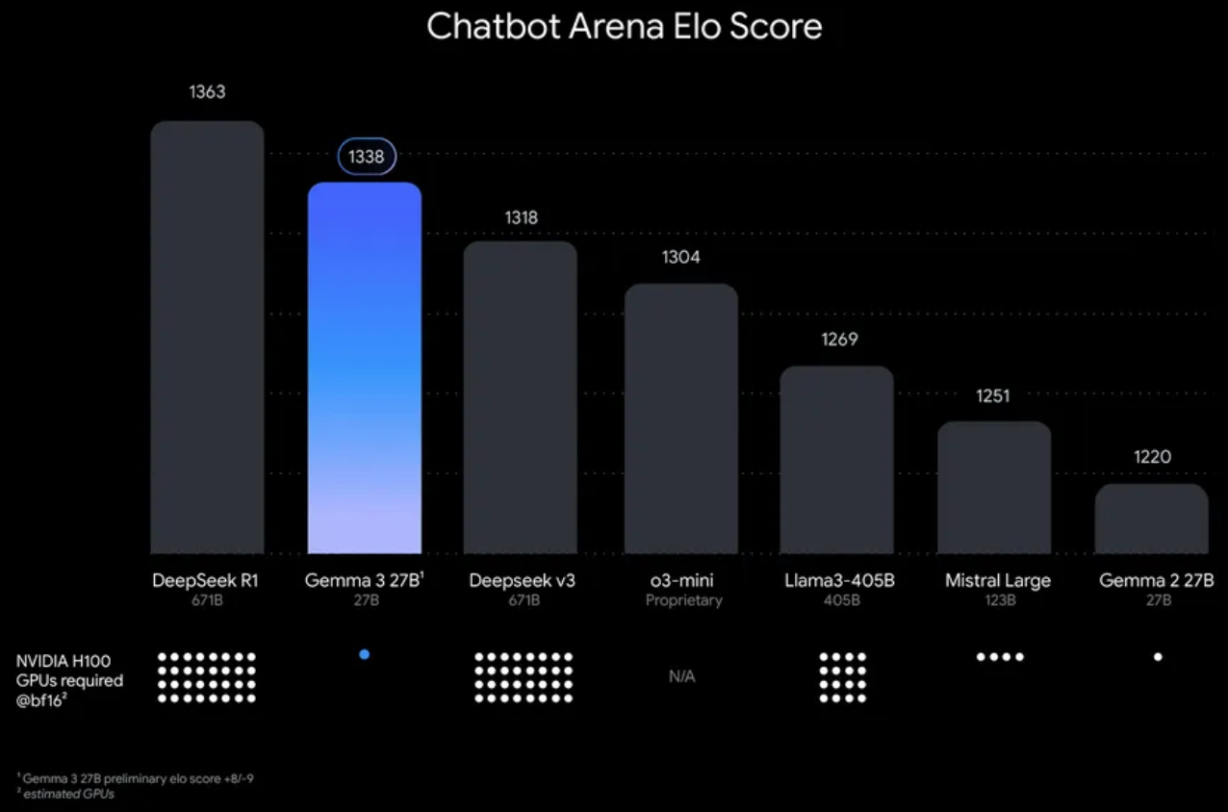
Google Gemma 3 27B The most capable model you can run on a single GPU or TPU
Source: https://blog.google/technology/developers/gemma-3/

Slide 28
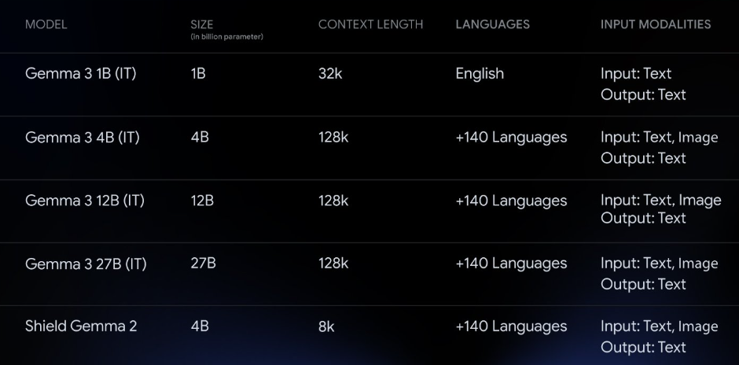
Google Gemma 3 Multimodality (vision-language input and text outputs)
Source: https://developers.googleblog.com/en/introducing-gemma3/

Slide 29
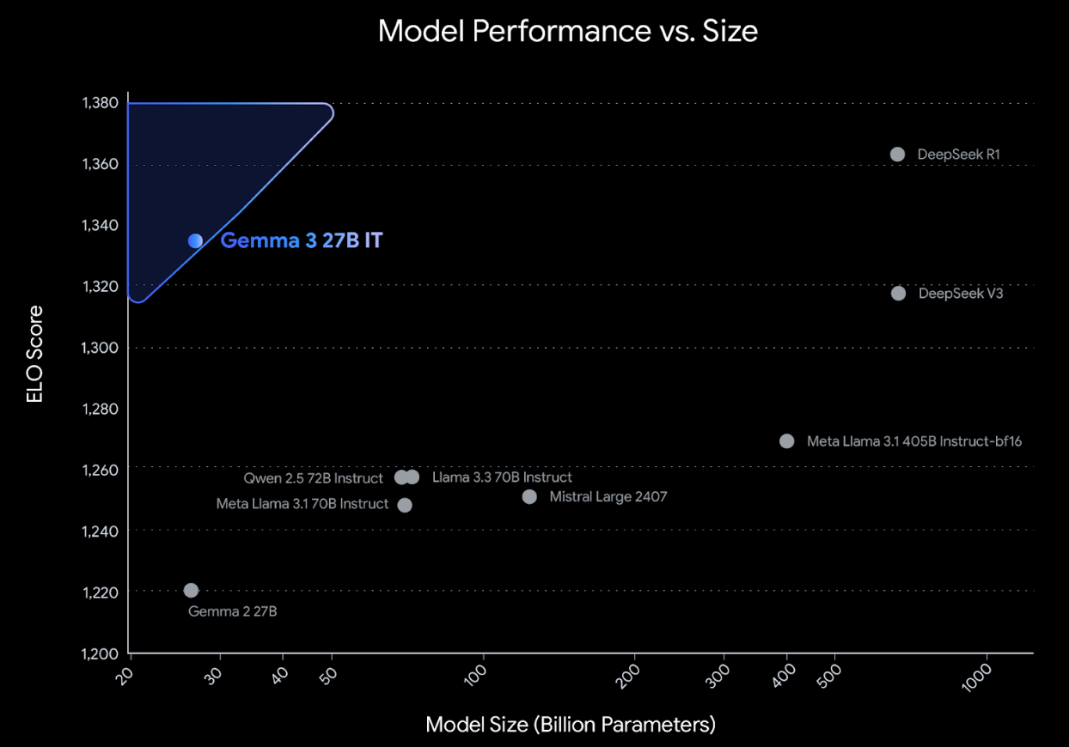
Google Gemma 3: Pre-training and Post-training (distillation, reinforcement learning, and model merging)
Source: https://developers.googleblog.com/en/introducing-gemma3/

Slide 30
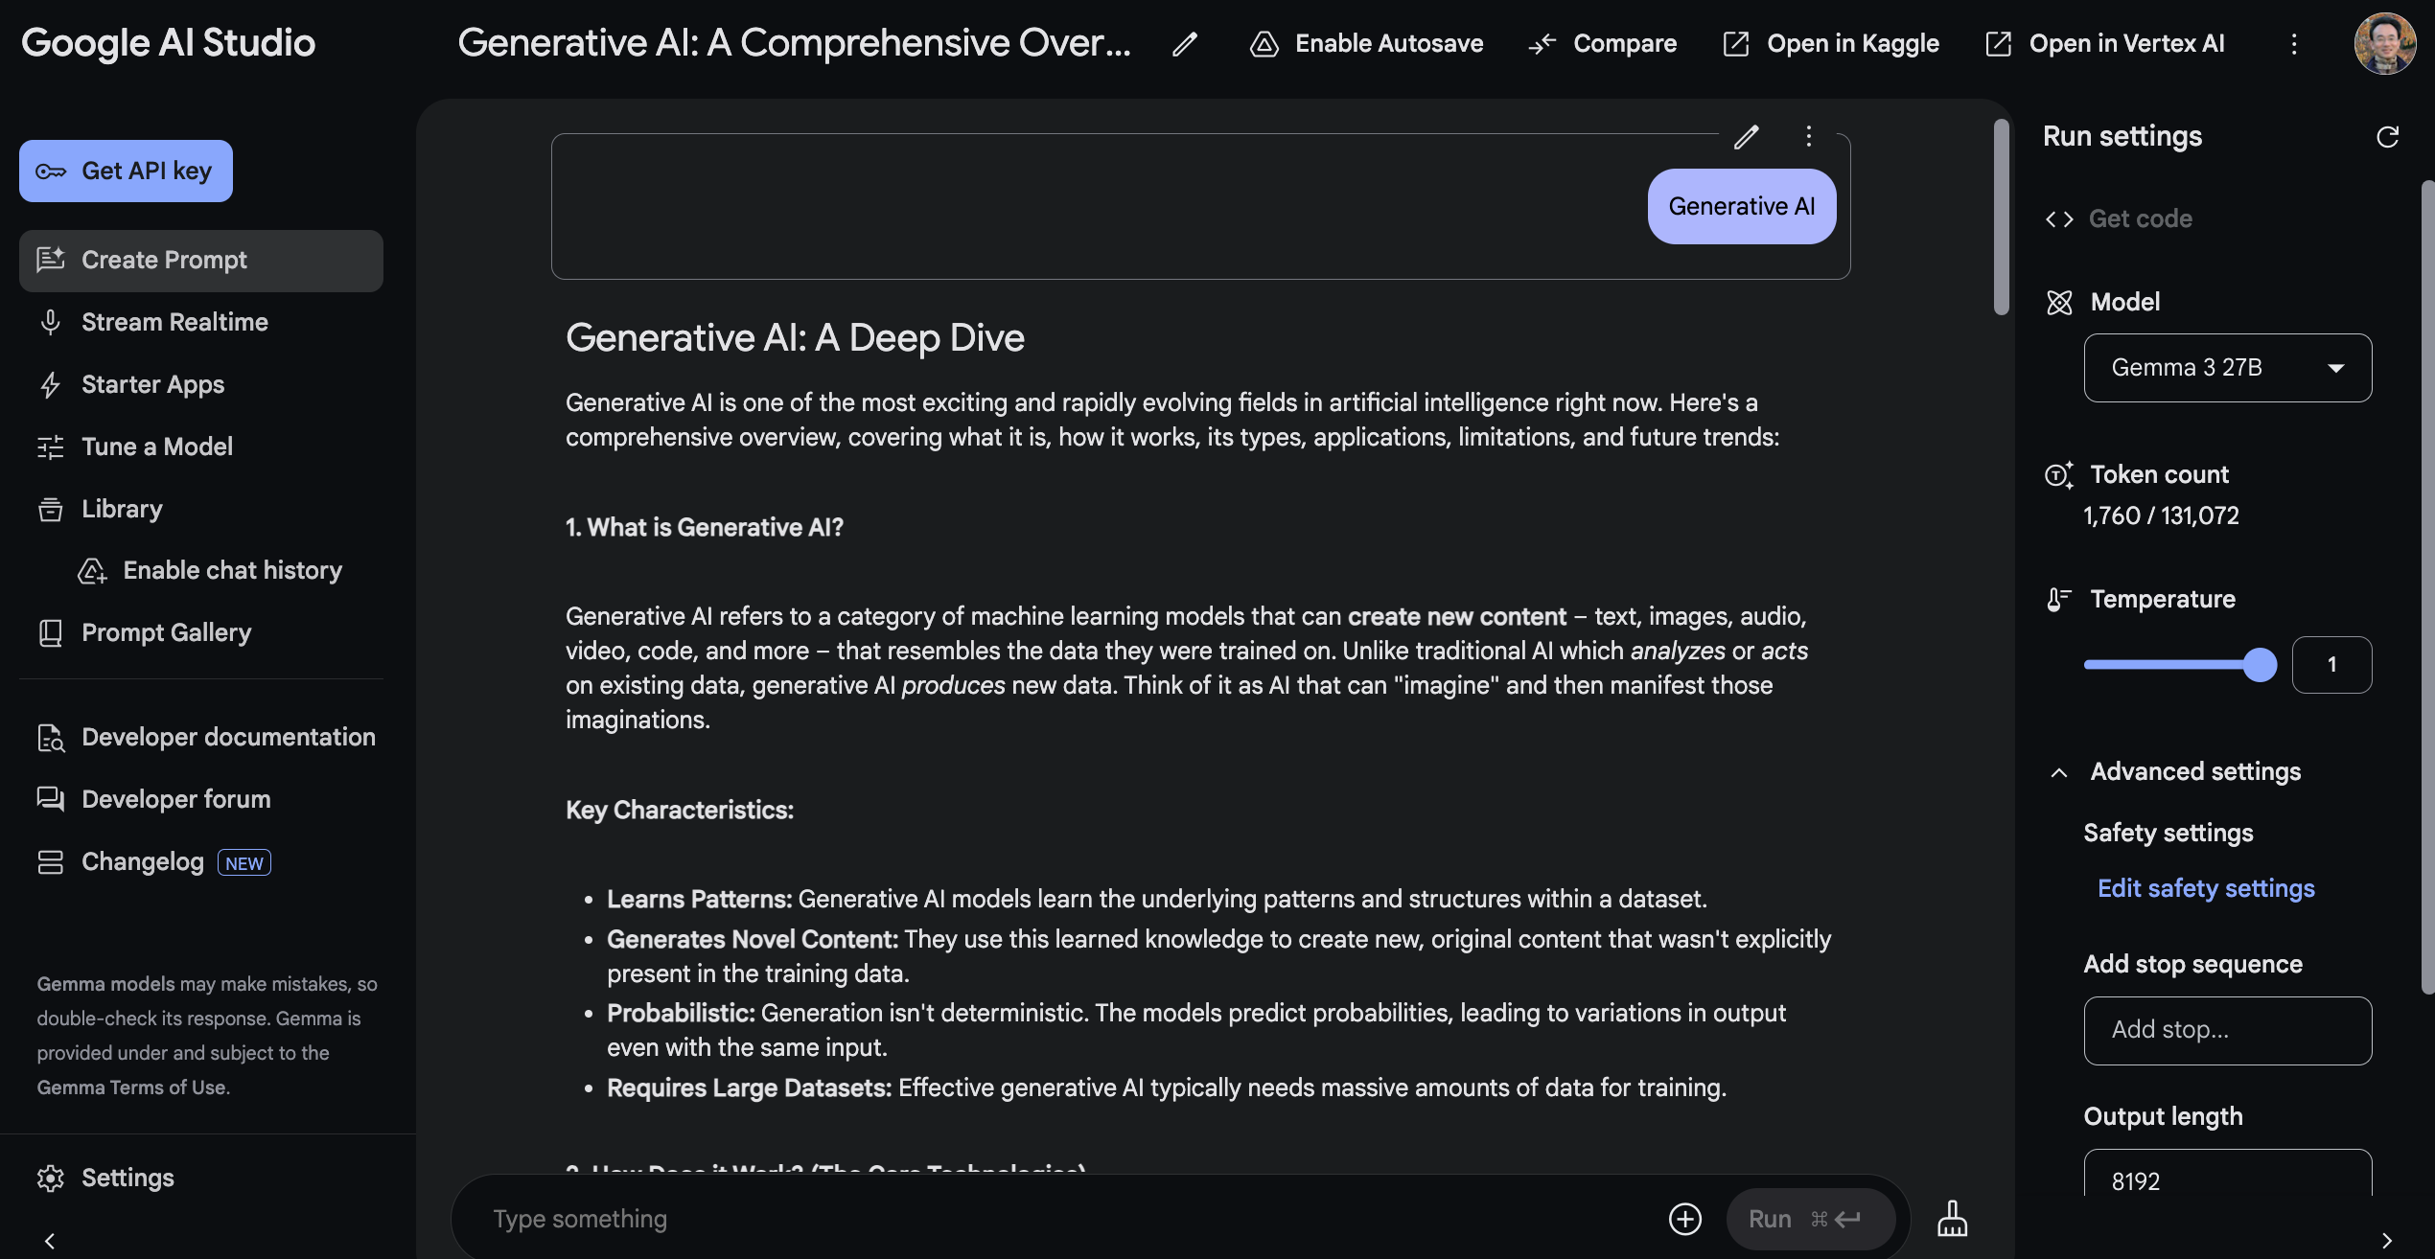
Google AI Studio (Gemma 3 27B)
Source: https://aistudio.google.com/

Slide 31
AI Technology Applications in Sustainability
1. 永續AI導入介紹 (Introduction to Sustainable AI)
2. AI在智慧能源管理的應用 (AI in Smart Energy Management)
3. AI在氣候變遷與環境監測的應用 (AI in Climate Change and Environmental Monitoring)
4. AI在循環經濟的應用案例 (AI in the Circular Economy)
5. AI永續技術專案小組討論與應用構想設計 (Sustainable AI Project Team Discussion and Application Design)
6. 綜合討論 (Open Discussion)

Slide 32
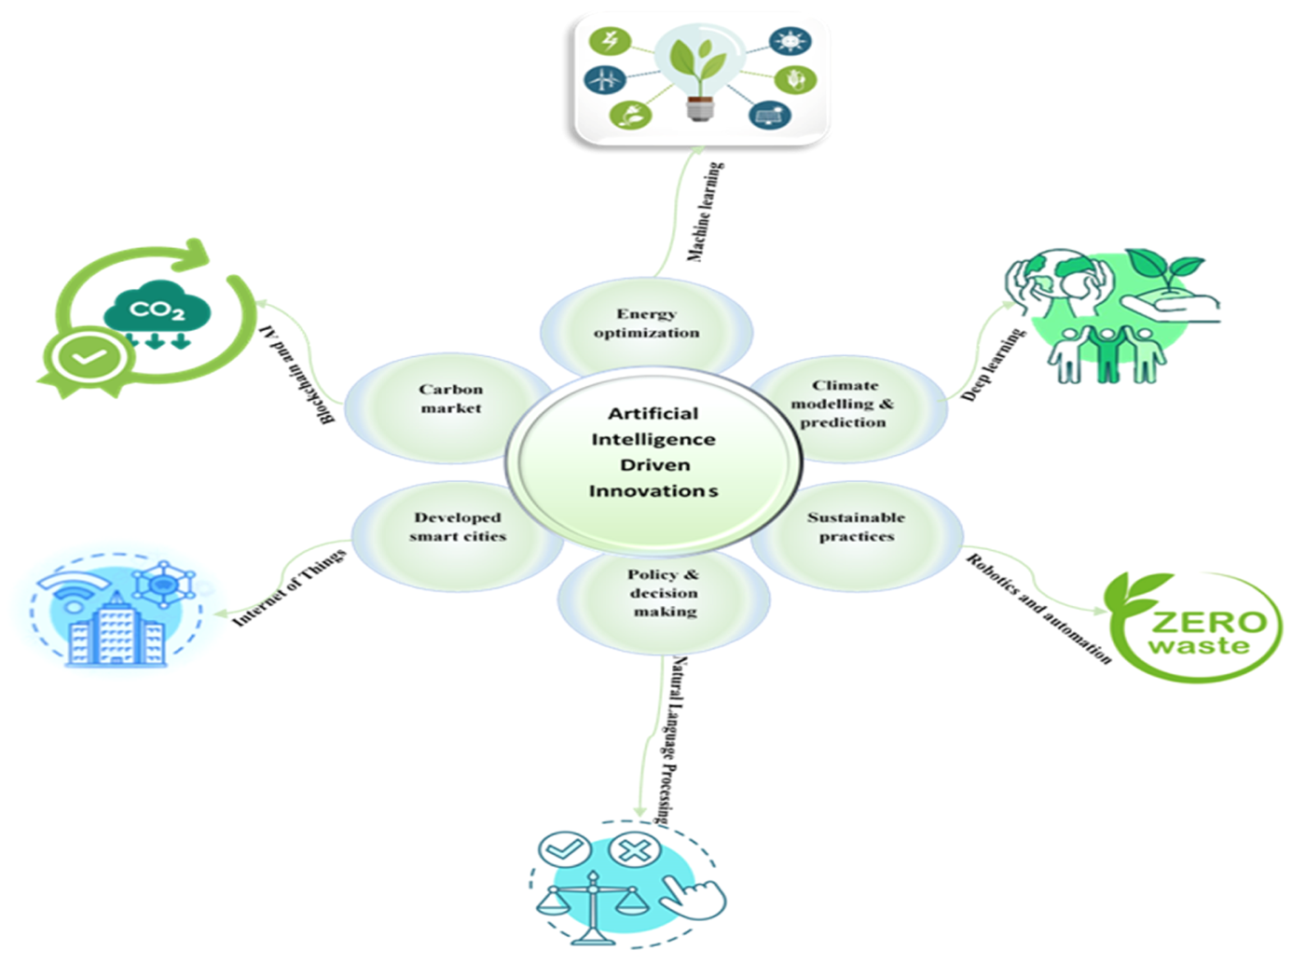
AI Innovations for Net-Zero Transformation
Source: Olawade, D. B., Wada, O. Z., David-Olawade, A. C., Fapohunda, O., Ige, A. O., & Ling, J. (2024). Artificial intelligence potential for net zero sustainability: Current evidence and prospects. Next Sustainability, 4, 100041.

Slide 33
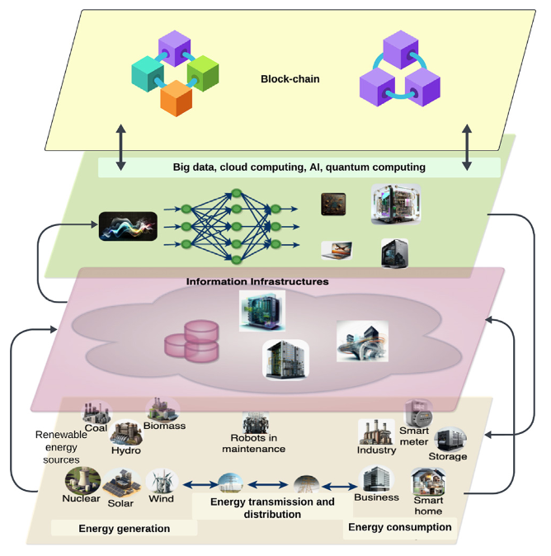
AI Technology for Net-Zero Energy Transition
Source: Ferdaus, M. M., Dam, T., Anavatti, S., & Das, S. (2024). Digital technologies for a net-zero energy future: A comprehensive review. Renewable and Sustainable Energy Reviews, 202, 114681.

Slide 34
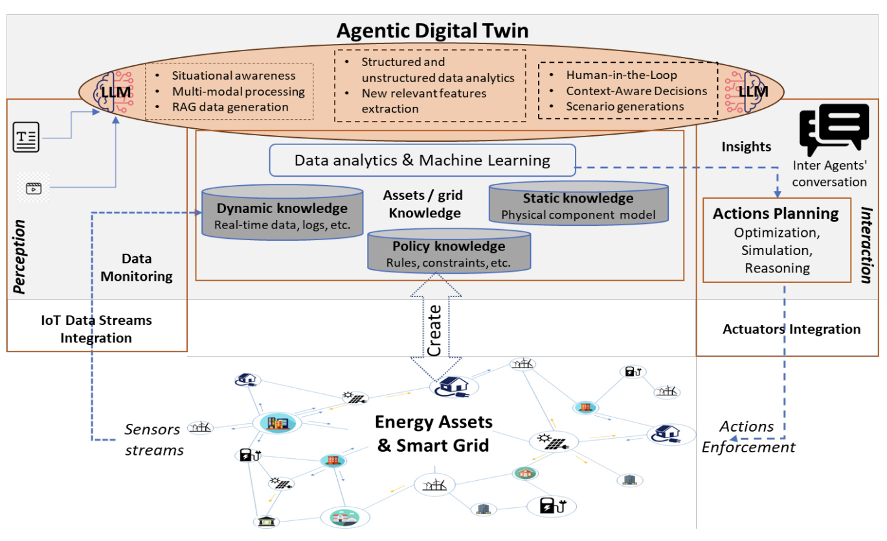
AI for Energy Systems and Agentic Digital Twins
Source: Antonesi, Gabriel, Tudor Cioara, Ionut Anghel, Vasilis Michalakopoulos, Elissaios Sarmas, and Liana Toderean. "From Transformers to Large Language Models: A systematic review of AI applications in the energy sector towards Agentic Digital Twins." arXiv preprint arXiv:2506.06359 (2025).

Slide 35
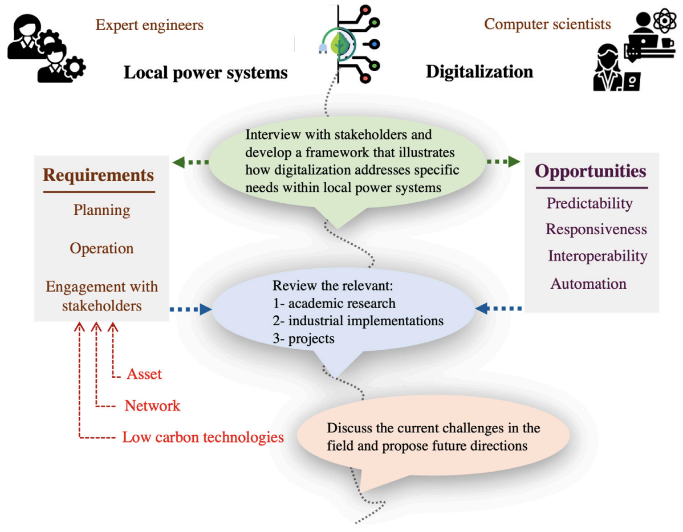
Local Power System Digitalization Transition to Net-Zero
Source: Azizi, Elnaz, Weiqi Hua, Bruce Stephen, David CH Wallom, and Malcolm Mcculloch. "Digitalization opportunities to enable local power system transition to net-zero." Energy for Sustainable Development 84 (2025): 101596.

Slide 36
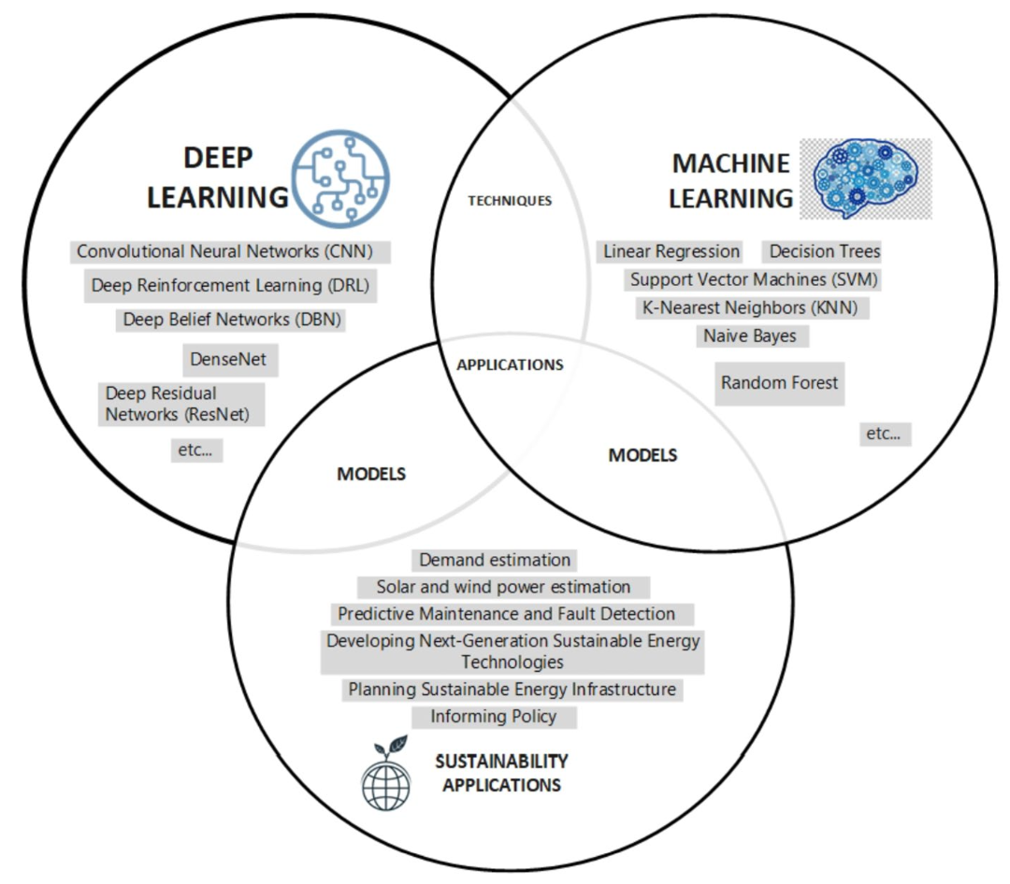
ML and DL for Sustainability Applications
Source: Javed, Haseeb, Fatma Eid, Shaker El-Sappagh, and Tamer Abuhmed. "Sustainable energy management in the AI era: a comprehensive analysis of ML and DL approaches." Computing 107, no. 6 (2025): 132.

Slide 37
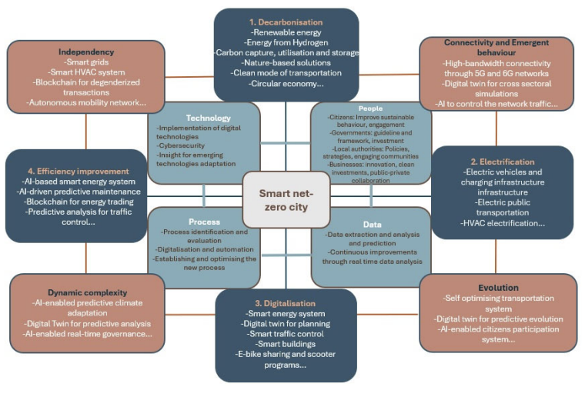
Digital Transformation for Smart Net-Zero Cities (Technology, People, Data, and Process)
Source: Jouzdani, Farzaneh Mohammadi, Vahid Javidroozi, Hanifa Shah, and Monica Mateo Garcia. "A Systemic Digital Transformation for Smart Net-Zero Cities: A State-of-the-Art Review." J 8, no. 1 (2025): 11.

Slide 38
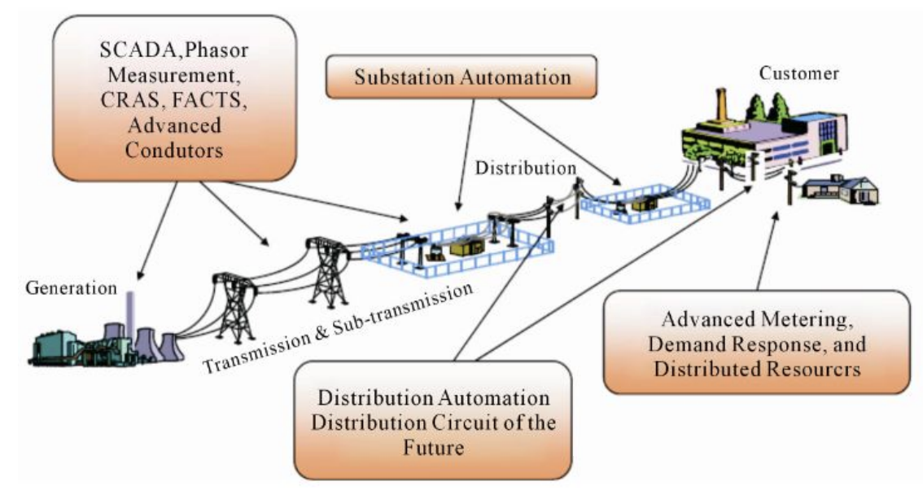
Elements of a Smart Grid
Source: Biswas, Parag, Abdur Rashid, Abdullah Al Masum, MD Abdullah Al Nasim, ASM Anas Ferdous, Kishor Datta Gupta, and Angona Biswas. "An extensive and methodical review of smart grids for sustainable energy management-addressing challenges with ai, renewable energy integration and leading-edge technologies." IEEE Access (2025).

Slide 39
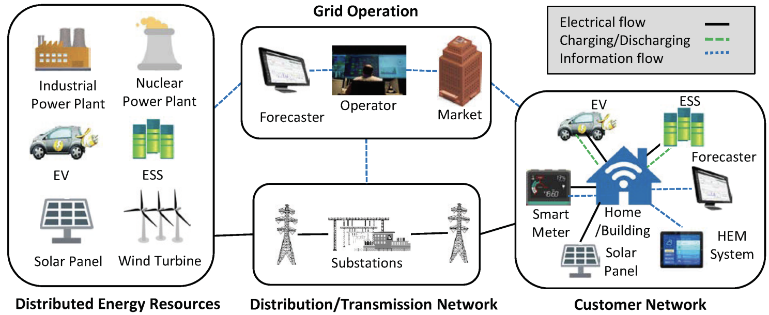
AI in Decentralized Intelligent Power Grids
Components
Distributed Generation
Distribution and Management
Smart Consumption
Source: Biswas, Parag, Abdur Rashid, Abdullah Al Masum, MD Abdullah Al Nasim, ASM Anas Ferdous, Kishor Datta Gupta, and Angona Biswas. "An extensive and methodical review of smart grids for sustainable energy management-addressing challenges with ai, renewable energy integration and leading-edge technologies." IEEE Access (2025).

Slide 40
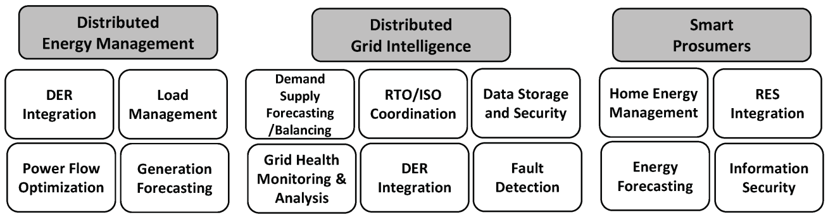
AI in Decentralized Intelligent Power Grids
Applications
Distributed Generation
Distribution and Management
Smart Consumption
Source: Biswas, Parag, Abdur Rashid, Abdullah Al Masum, MD Abdullah Al Nasim, ASM Anas Ferdous, Kishor Datta Gupta, and Angona Biswas. "An extensive and methodical review of smart grids for sustainable energy management-addressing challenges with ai, renewable energy integration and leading-edge technologies." IEEE Access (2025).

Slide 41
AI in Decentralized Intelligent Power Grids
AI Technology
Distributed Generation
Distribution and Management
Smart Consumption
Multi-agent system-based microgrid operation strategy for DR
Distributed grid intelligence using FREEDM system to manage the DERs
ANN for optimizing distributed grid operation
Consensus-based distributed intelligence for optimizing SG control
Optimization of distributed generation operation using GA
ANN for forecasting local energy demand
Central Information Model (CIM) for implementing VPP communication and control architecture in SCADA
Deep Learning (Support Vector Regression (SVR), Recurrent Neural Network (RNN)) for electricity price forecasting
Markov Decision Process and RL based smart energy community management
Meta-heuristic algorithm for regulating voltage profile
ANN for detecting energy fraud Multi-service energy storage for providing shared ownership of ESS between local network operator and customers
ANN for DSM for smart consumers
ANN for forecasting day-ahead load profile
Machine Learning (support vector machine, ANN) for predicting electricity price
Deep learning (Conditional Restricted Boltzmann Machine (CRBM)) for forecasting building energy consumption
ANN and dynamic differential evolution for demand side management
ANN and RL for demand response of HEM
Source: Biswas, Parag, Abdur Rashid, Abdullah Al Masum, MD Abdullah Al Nasim, ASM Anas Ferdous, Kishor Datta Gupta, and Angona Biswas. "An extensive and methodical review of smart grids for sustainable energy management-addressing challenges with ai, renewable energy integration and leading-edge technologies." IEEE Access (2025).

Slide 42
AI Technology Applications in Sustainability
1. 永續AI導入介紹 (Introduction to Sustainable AI)
2. AI在智慧能源管理的應用 (AI in Smart Energy Management)
3. AI在氣候變遷與環境監測的應用 (AI in Climate Change and Environmental Monitoring)
4. AI在循環經濟的應用案例 (AI in the Circular Economy)
5. AI永續技術專案小組討論與應用構想設計 (Sustainable AI Project Team Discussion and Application Design)
6. 綜合討論 (Open Discussion)

Slide 43
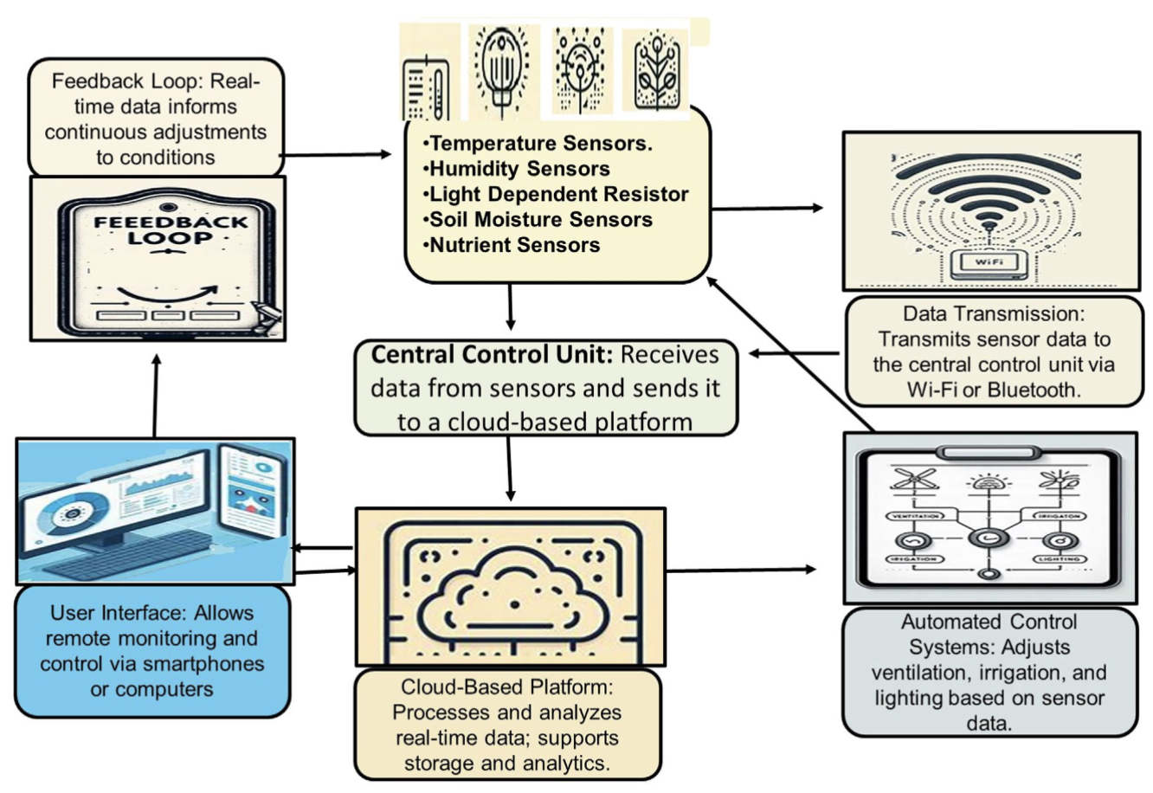
Integrated Real-time Data Monitoring and Control System for a Smart Greenhouse Environment
Source: Kaya, Cengiz. "Intelligent Environmental Control in Plant Factories: Integrating Sensors, Automation, and AI for Optimal Crop Production." Food and Energy Security 14, no. 1 (2025): e70026.

Slide 44
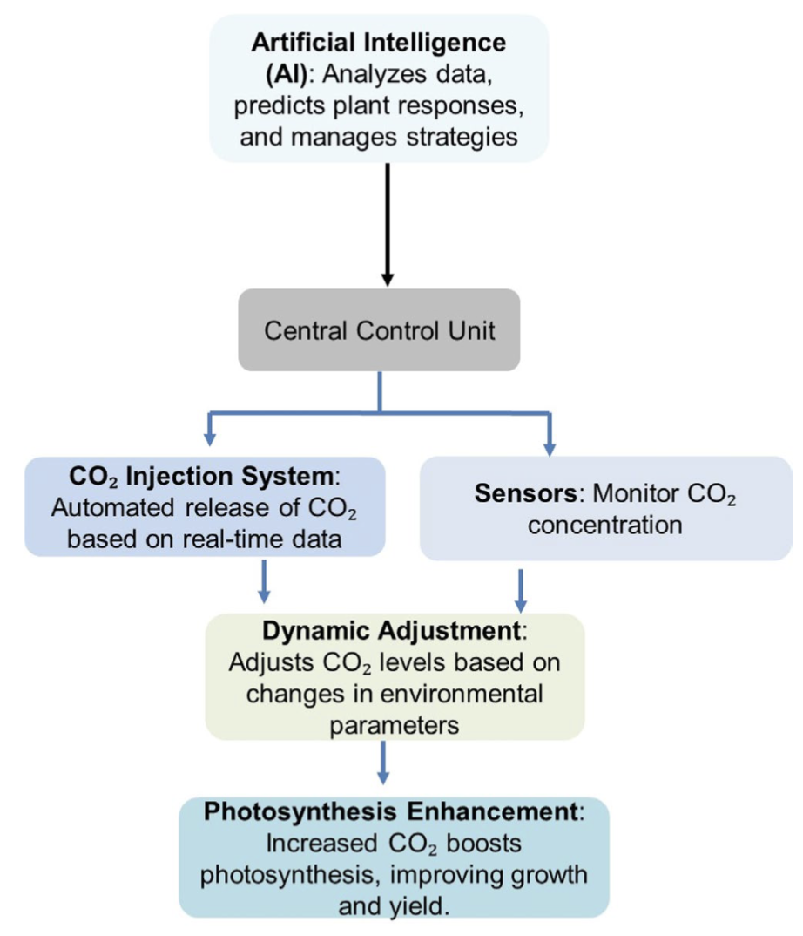
AI Environmental Control System with CO₂ Enrichment
Source: Kaya, Cengiz. "Intelligent Environmental Control in Plant Factories: Integrating Sensors, Automation, and AI for Optimal Crop Production." Food and Energy Security 14, no. 1 (2025): e70026.

Slide 45
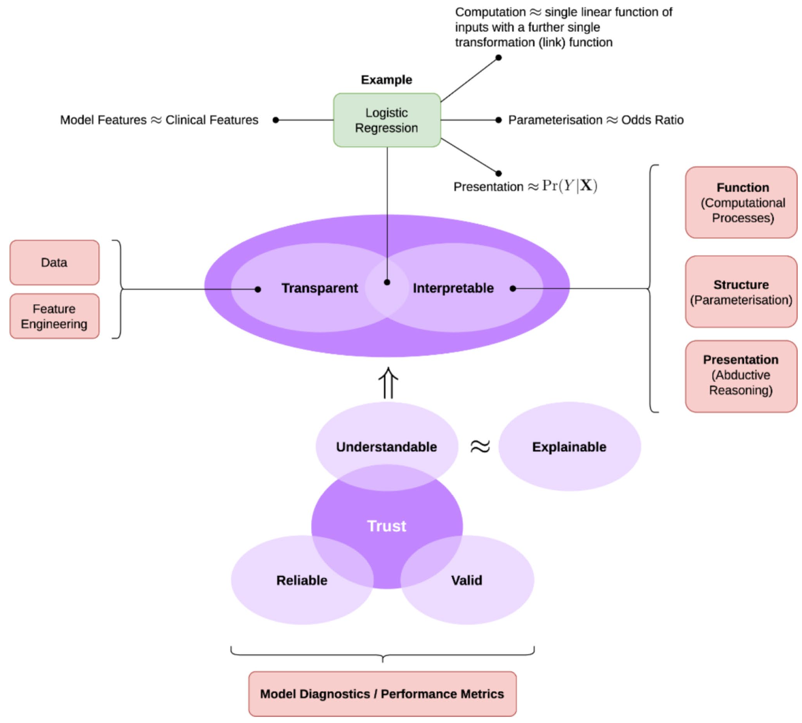
AI in Climate Change Predictive Modeling
Source: Ukoba, Kingsley, Oluwatayo Racheal Onisuru, Tien-Chien Jen, Daniel M. Madyira, and Kehinde O. Olatunji. "Predictive modeling of climate change impacts using Artificial Intelligence: a review for equitable governance and sustainable outcome." Environmental Science and Pollution Research (2025): 1-20.

Slide 46
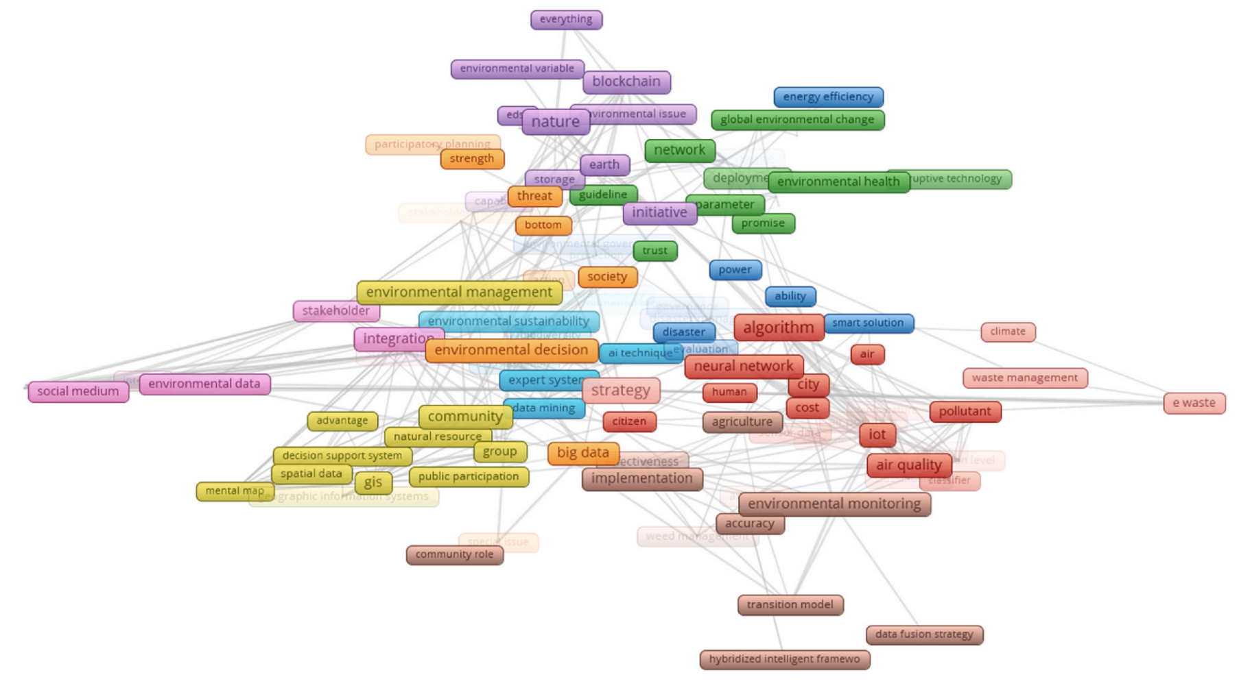
AI in Environmental Management
Source: Santos, Márcia RC, and Luísa Cagica Carvalho. "AI-driven participatory environmental management: Innovations, applications, and future prospects." Journal of Environmental Management 373 (2025): 123864.

Slide 47
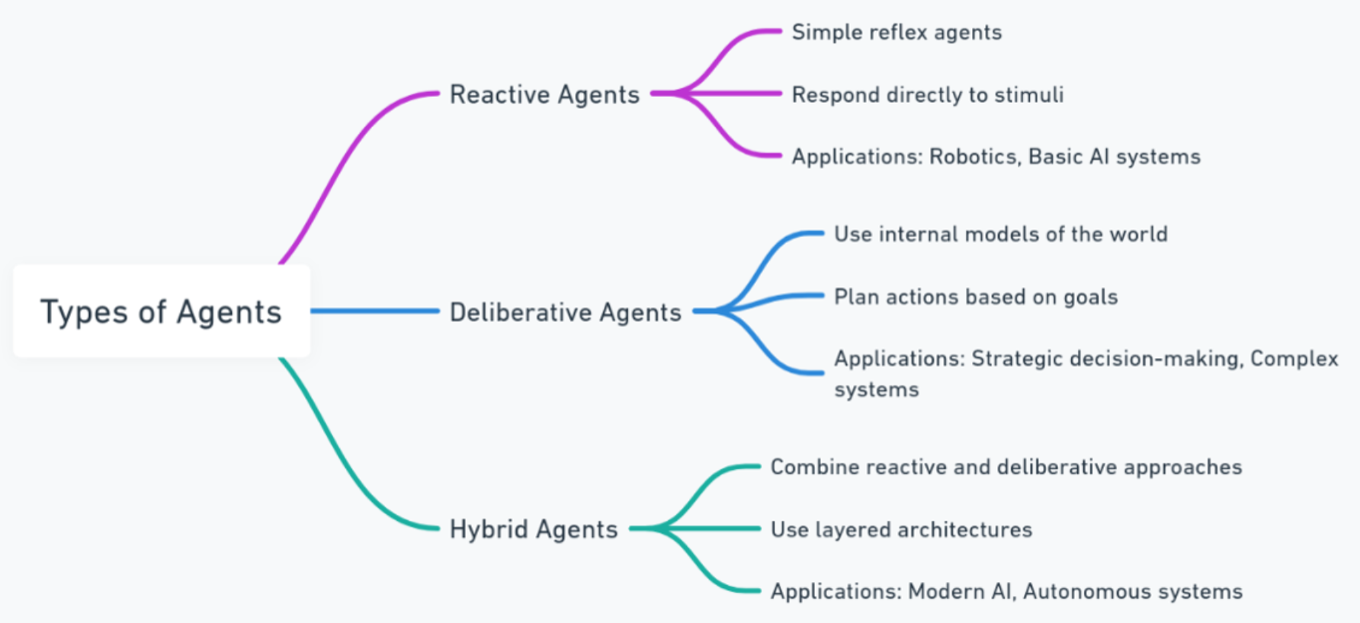
AI Agents in Environmental Sciences
Source: Miller, Tymoteusz, Irmina Durlik, Ewelina Kostecka, Polina Kozlovska, Adrianna Łobodzińska, Sylwia Sokołowska, and Agnieszka Nowy. "Integrating artificial intelligence agents with the internet of things for enhanced environmental monitoring: applications in water quality and climate data." Electronics 14, no. 4 (2025): 696.

Slide 48
AI Technology Applications in Sustainability
1. 永續AI導入介紹 (Introduction to Sustainable AI)
2. AI在智慧能源管理的應用 (AI in Smart Energy Management)
3. AI在氣候變遷與環境監測的應用 (AI in Climate Change and Environmental Monitoring)
4. AI在循環經濟的應用案例 (AI in the Circular Economy)
5. AI永續技術專案小組討論與應用構想設計 (Sustainable AI Project Team Discussion and Application Design)
6. 綜合討論 (Open Discussion)

Slide 49
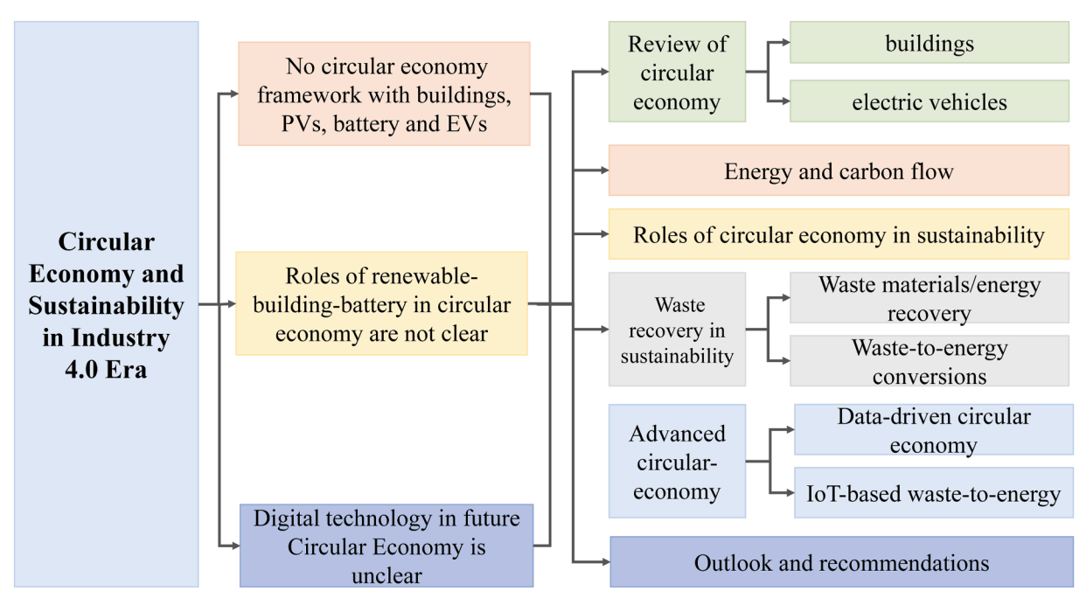
AI-driven digital circular economy with material and energy sustainability for industry 4.0
Source: Zhou, Yuekuan. "AI-driven Digital Circular Economy with Material and Energy Sustainability for Industry 4.0." Energy and AI (2025): 100508.

Slide 50
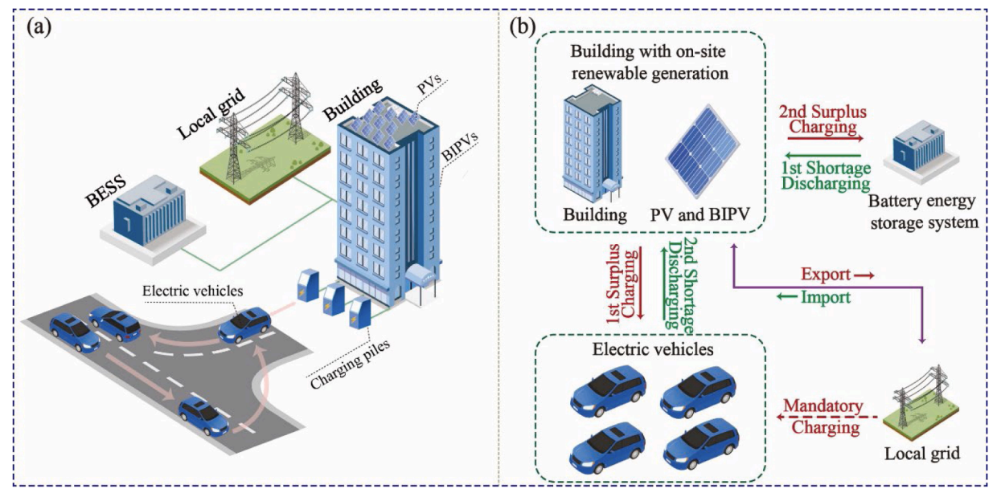
AI for Circular Economy
Source: Zhou, Yuekuan. "AI-driven Digital Circular Economy with Material and Energy Sustainability for Industry 4.0." Energy and AI (2025): 100508.

Slide 51
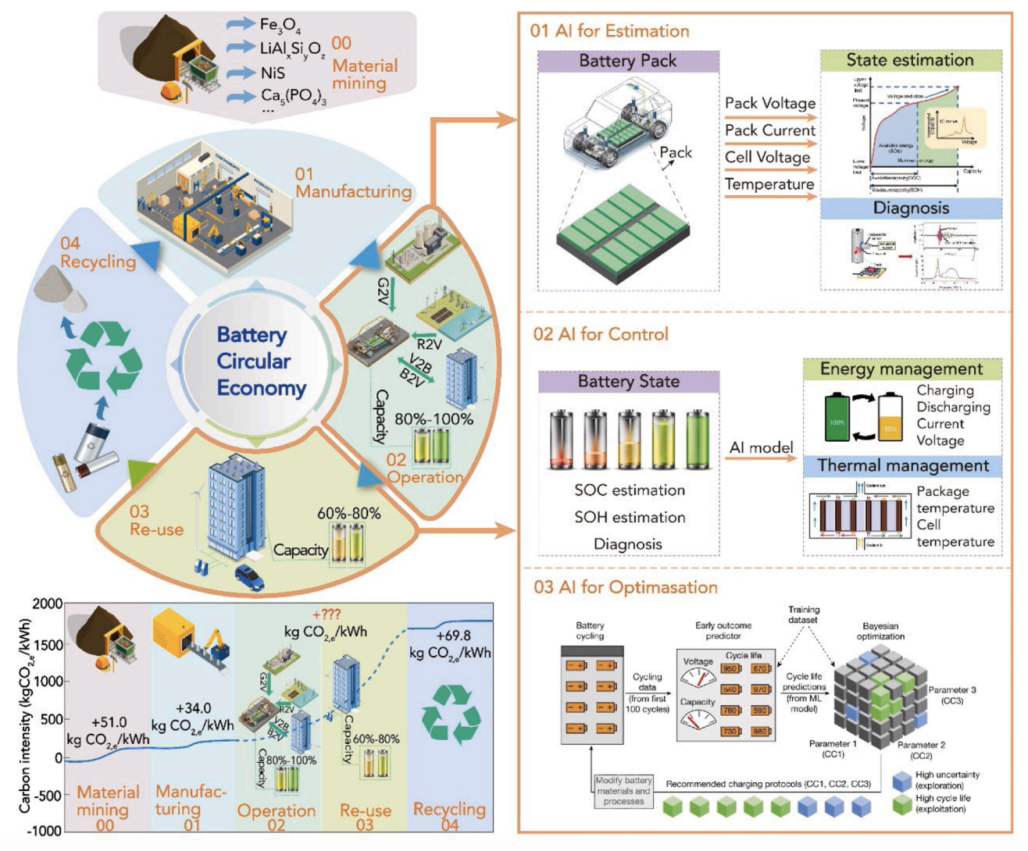
AI and Data-driven Battery Circular Economy
Source: Zhou, Yuekuan. "AI-driven Digital Circular Economy with Material and Energy Sustainability for Industry 4.0." Energy and AI (2025): 100508.

Slide 52
AI Technology Applications in Sustainability
1. 永續AI導入介紹 (Introduction to Sustainable AI)
2. AI在智慧能源管理的應用 (AI in Smart Energy Management)
3. AI在氣候變遷與環境監測的應用 (AI in Climate Change and Environmental Monitoring)
4. AI在循環經濟的應用案例 (AI in the Circular Economy)
5. AI永續技術專案小組討論與應用構想設計 (Sustainable AI Project Team Discussion and Application Design)
6. 綜合討論 (Open Discussion)

Slide 53
Net-Zero Transformation
Ambition
Aligned to achieving global net zero by no later than 2050 & to limit warming to 1.5°C
Governance
Accountability driven from the top
Strategy
Embedded and aligned net zero into company strategy
Enterprise
Key operating model changes in support of transformation
Supply chains
Transformed net zero supply chains
Innovation
Developed innovation and technologies to deliver net zero
Finance
Financing the net zero transformation
Transparency
Communicating action
Engagement
Enhancing the pace and scale of net zero action
Source: https://www.pwc.com/us/en/services/esg/library/building-blocks-for-net-zero-transformation.html

Slide 54
ESG and Net-Zero: The Essentials
Environmental
Climate impact, resource use, pollution, biodiversity
Social
Labor practices, human rights, community impact, diversity & inclusion
Governance
Transparency, ethics, board structure, risk management
Net-Zero
Balancing emissions produced with emissions removed globally

Slide 55
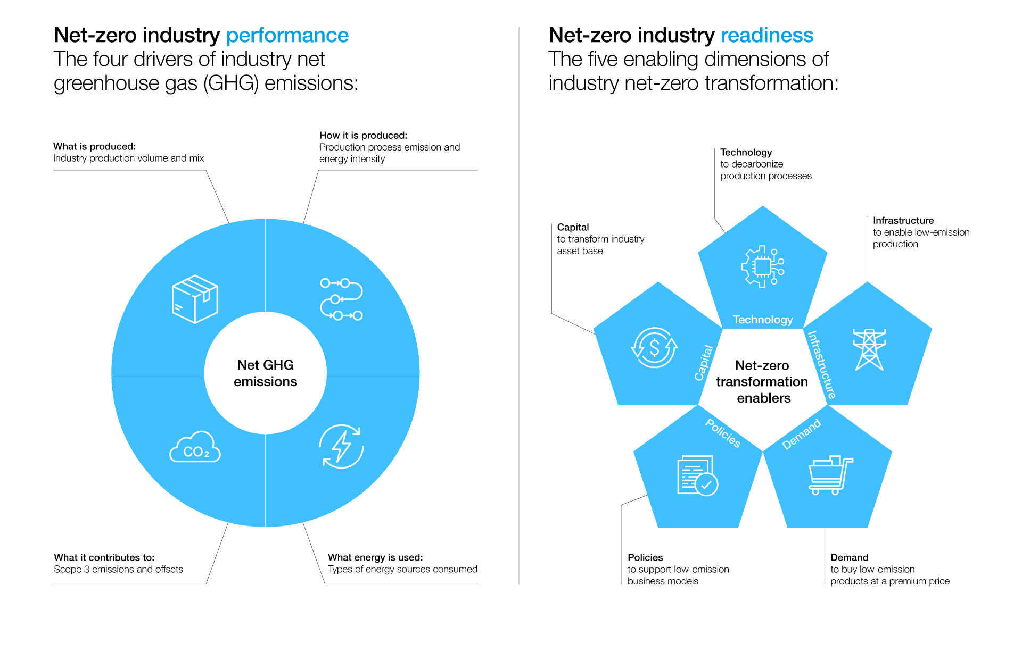
Net-Zero Transformation Enablers
Source: https://www.weforum.org/agenda/2022/07/net-zero-tracker/

Slide 56
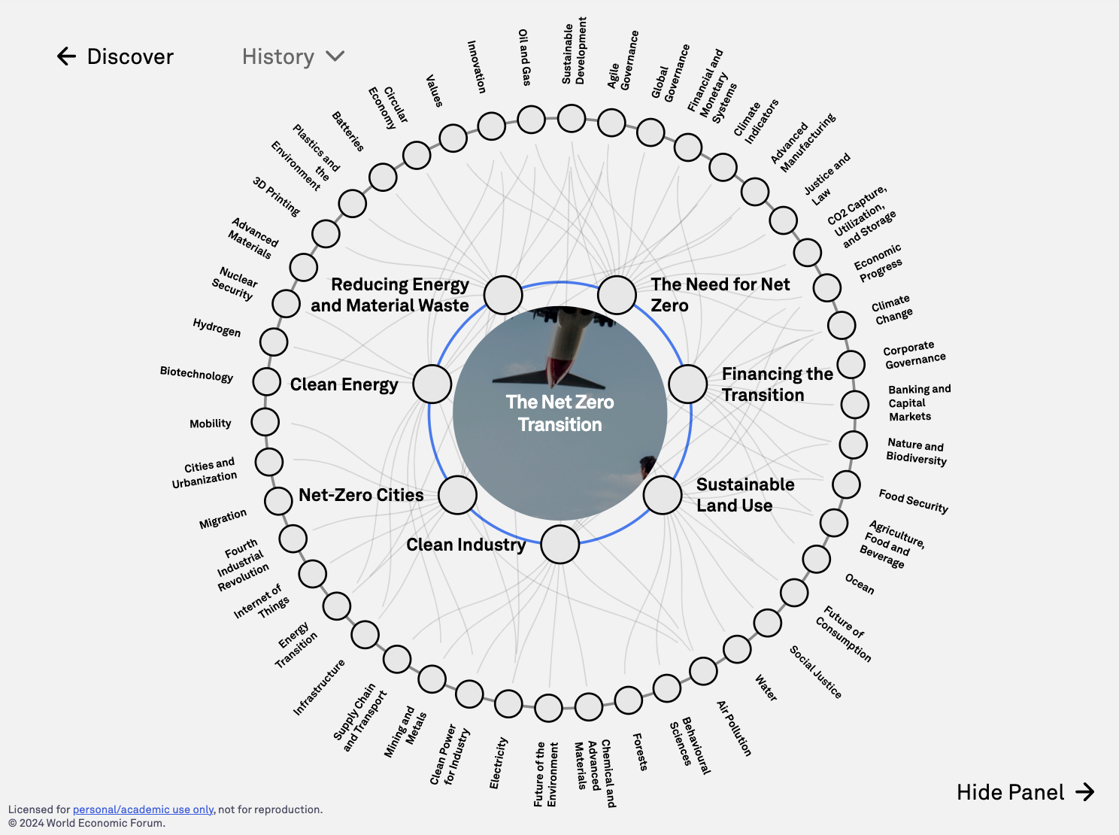
The Net Zero Transition
Source: https://intelligence.weforum.org/topics/a1G680000004C93EAE

Slide 57
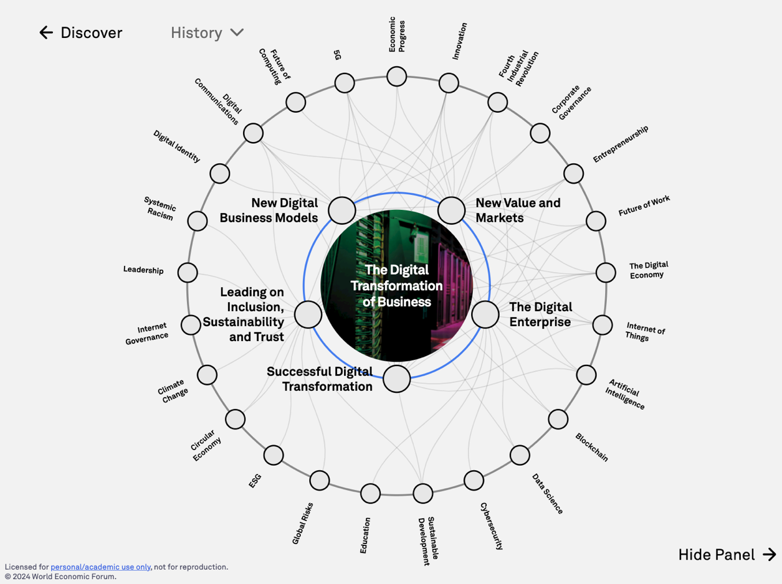
The Digital Transformation of Business
Source: https://intelligence.weforum.org/topics/a1G0X000006DIDZUA4

Slide 58
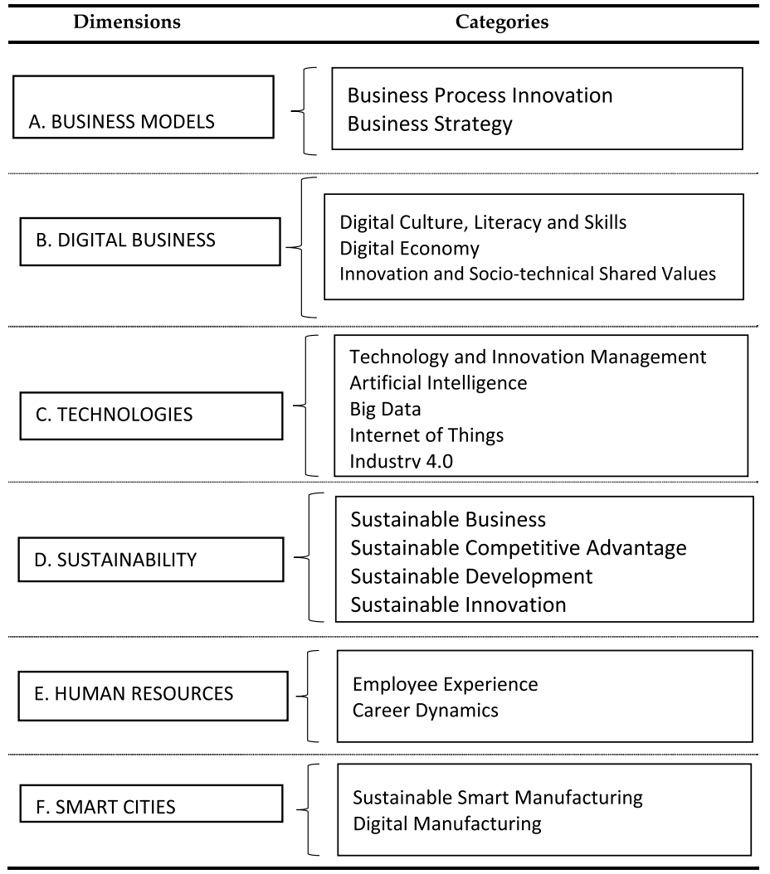
Digital Transformation
Source: Reis, João, and Nuno Melão (2023). "Digital transformation: A meta-review and guidelines for future research." Heliyon (2023).

Slide 59
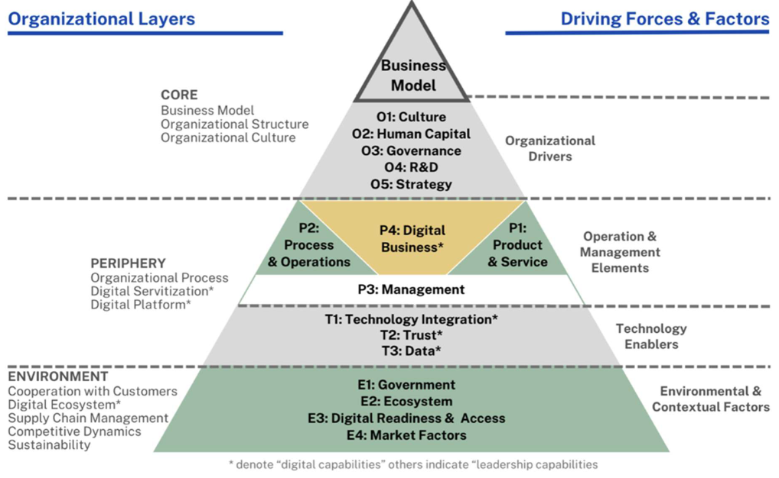
Digital Transformation Framework
Source: Tangwaragorn, P., Chareonruk, N., Viriyasitavat, W., Tangmanee, C., Kanawattanachai, P., Hoonsopon, D., ... & Rhuwadhana, P. (2024). Analyzing Key Drivers of Digital Transformation: A Review and Framework. Journal of Industrial Information Integration, 100680.

Slide 60
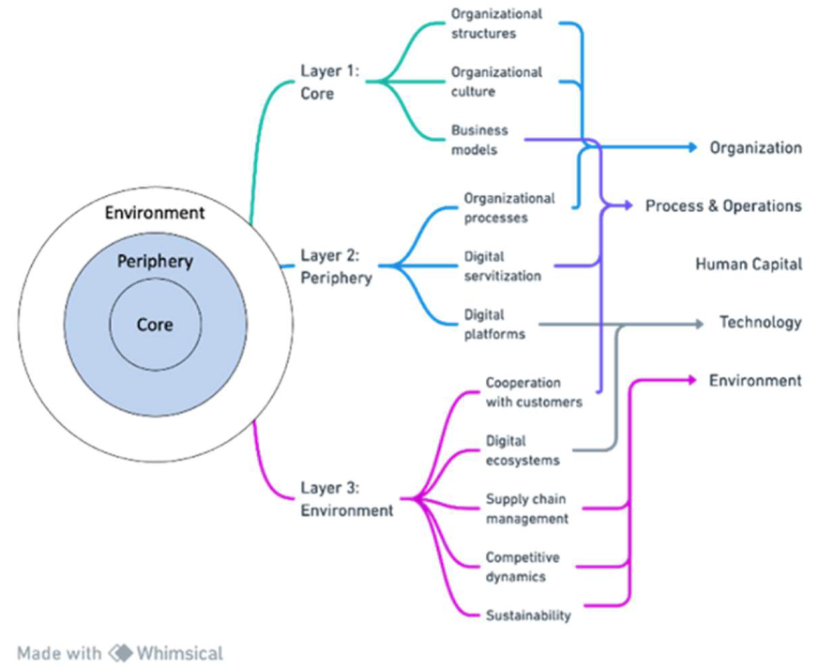
Digital Transformation: Theoretical and practical dimensions
Source: Tangwaragorn, P., Chareonruk, N., Viriyasitavat, W., Tangmanee, C., Kanawattanachai, P., Hoonsopon, D., ... & Rhuwadhana, P. (2024). Analyzing Key Drivers of Digital Transformation: A Review and Framework. Journal of Industrial Information Integration, 100680.

Slide 61


















Sustainable Development Goals (SDGs)
Source: https://sdgs.un.org/goals

Slide 62
Evolution of Sustainable Finance Research
Topic
SDGs: Sustainable Development Goals
SDGs
Innovative Financial Instrument
Impact Investing
ESG: Environmental, Social, and Governance
CSR: Corporate Social Responsibility
Conscious Capitalism
Climate Financing
Carbon Financing
Green Financing
Ethical Investing
Socially Responsible Investing
1986
1995
2005
2015
2020
Source: Kumar, S., Sharma, D., Rao, S., Lim, W. M., & Mangla, S. K. (2022). Past, present, and future of sustainable finance: Insights from big data analytics through machine learning of scholarly research. Annals of Operations Research, 1-44.

Slide 63
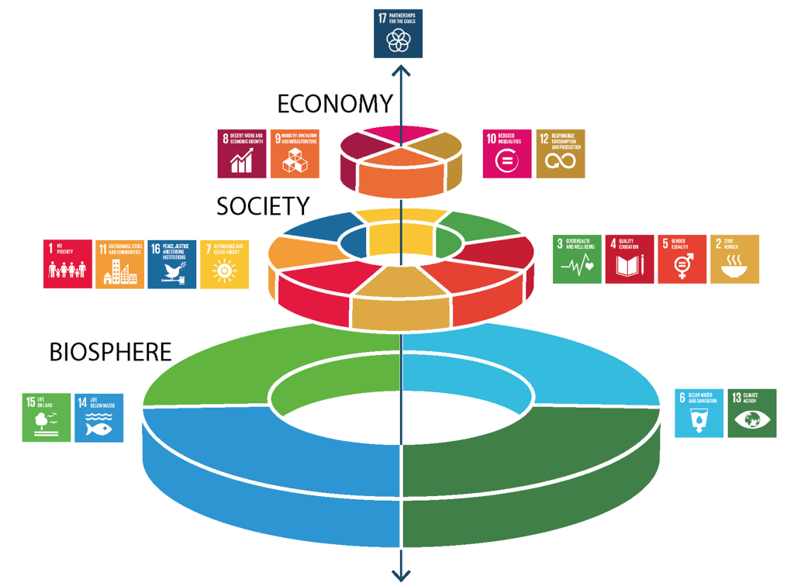
Sustainable Development Goals (SDGs) and 5P
Partnership
Peace
Prosperity
People
Planet
Source: Folke, Carl, Reinette Biggs, Albert V. Norström, Belinda Reyers, and Johan Rockström. "Social-ecological resilience and biosphere-based sustainability science.”Ecology and Society 21, no. 3 (2016).

Slide 64
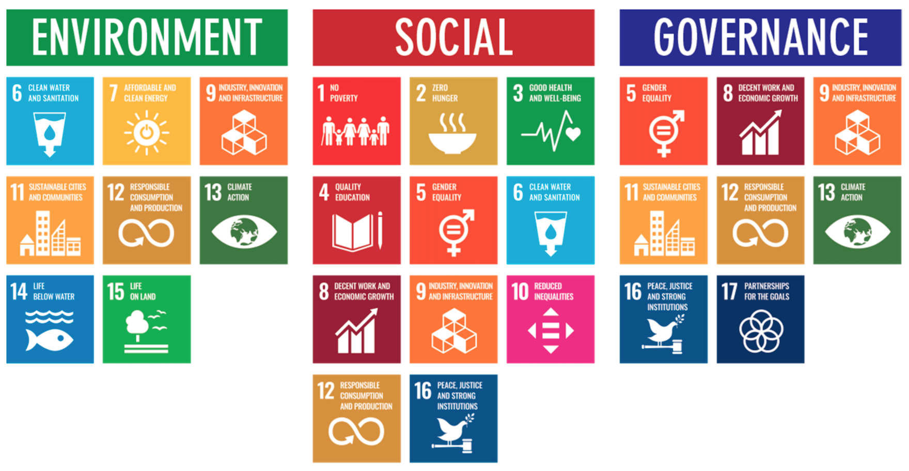
ESG to 17 SDGs
Source: Henrik Skaug Sætra (2021) "A Framework for Evaluating and Disclosing the ESG Related Impacts of AI with the SDGs." Sustainability 13, no. 15 (2021): 8503.

Slide 65
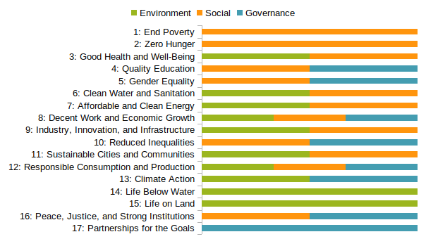
ESG to 17 SDGs
Source: https://sustainometric.com/esg-to-sdgs-connected-paths-to-a-sustainable-future/

Slide 66
Where ESG Meets – It's All Connected
Environmental Justice
Underserved communities disproportionately impacted by pollution, climate hazards
Responsible Tech Supply Chains
Resource extraction, e-waste, labor rights across the tech lifecycle
Inclusive Product Design
Accessibility, addressing digital divides, social impacts of technology.

Slide 67
Digital Transformation: Enabler and Challenge
Enabler
Data-driven decision-making, efficiency gains, new business models, collaboration
AI optimizing renewable energy
Challenge
Energy consumption, e-waste, planned obsolescence, AI ethics
AI servers representing increased energy use

Slide 68
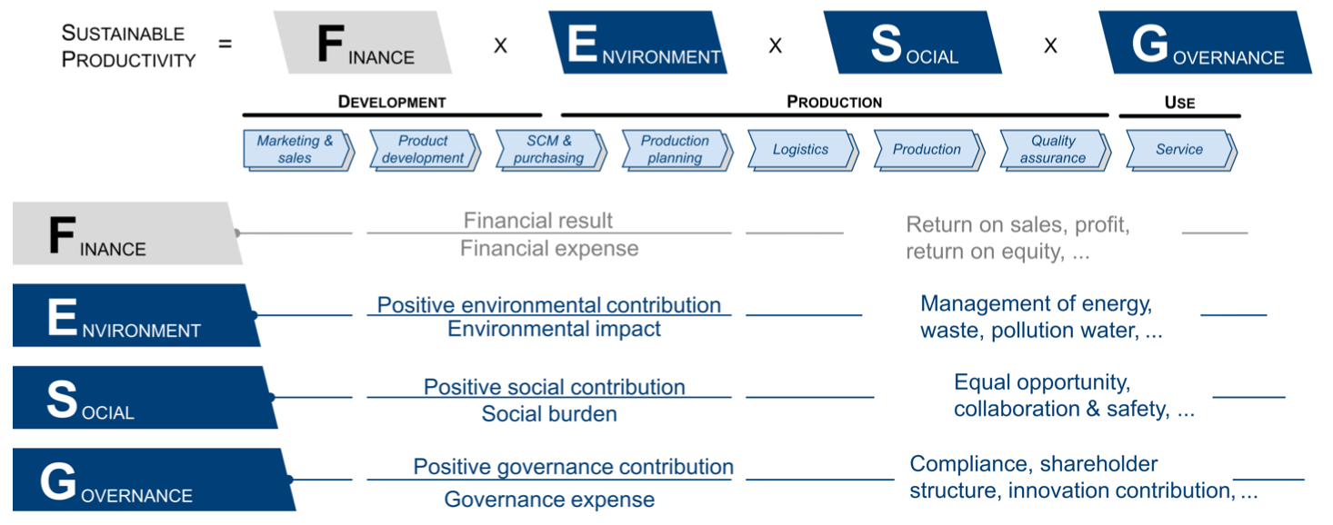
Sustainable Productivity: Finance ESG
Source: Huang, Ziqi, Yang Shen, Jiayi Li, Marcel Fey, and Christian Brecher (2021). "A survey on AI-driven digital twins in Industry 4.0: Smart manufacturing and advanced robotics." Sensors 21, no. 19: 6340.

Slide 69
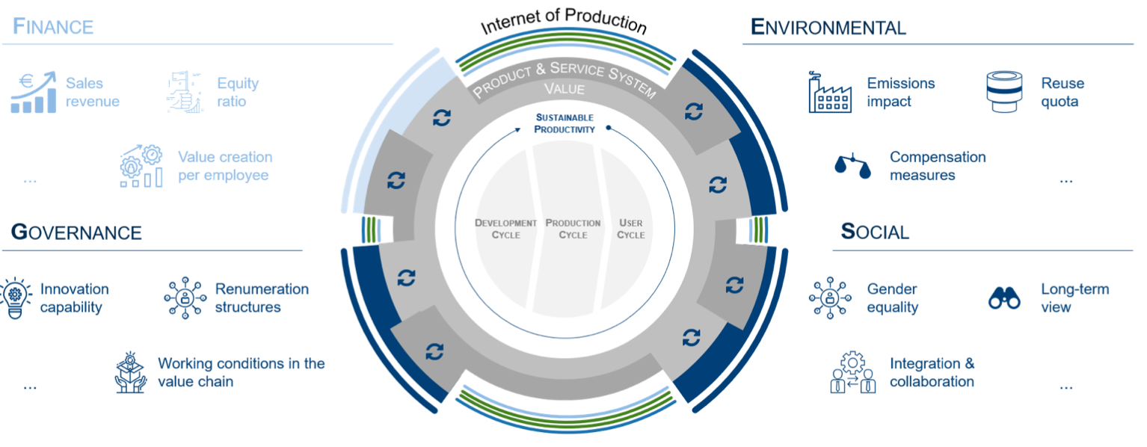
Sustainable Resilient Manufacturing ESG
Source: Huang, Ziqi, Yang Shen, Jiayi Li, Marcel Fey, and Christian Brecher (2021). "A survey on AI-driven digital twins in Industry 4.0: Smart manufacturing and advanced robotics." Sensors 21, no. 19: 6340.

Slide 70
ESG Indexes
MSCI ESG Index
Dow Jones Sustainability Indices (DJSI)
FTSE ESG Index

Slide 71
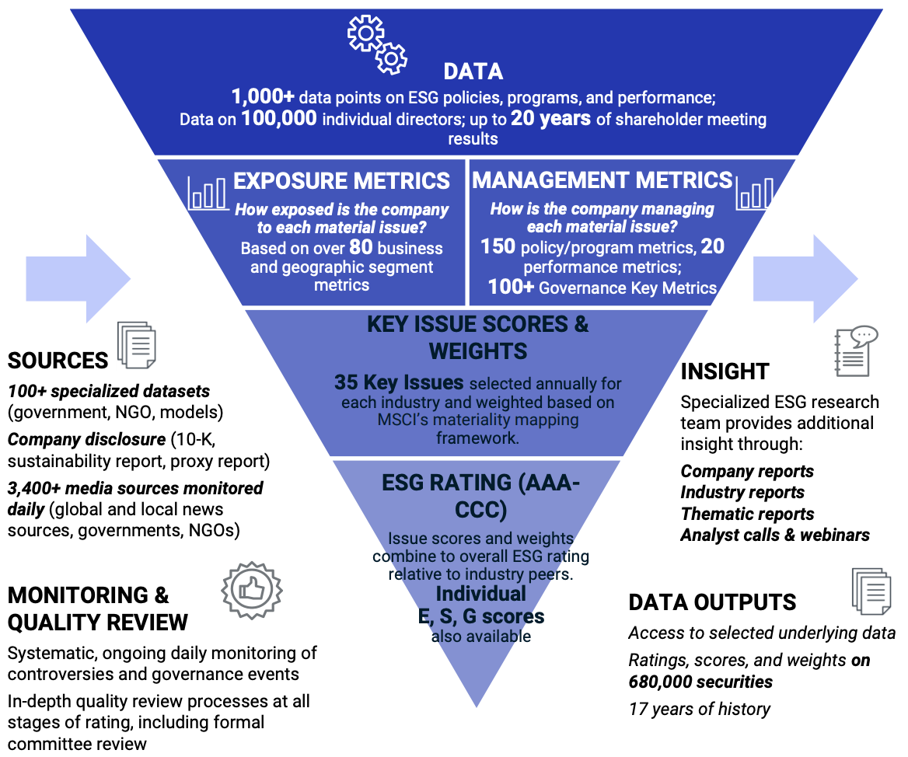
MSCI ESG Rating Framework
Source: https://www.msci.com/documents/1296102/21901542/ESG-Ratings-Methodology-Exec-Summary.pdf

Slide 72

MSCI ESG Key Issue Hierarchy
Source: https://www.msci.com/documents/1296102/21901542/ESG-Ratings-Methodology-Exec-Summary.pdf

Slide 73

MSCI Governance Model Structure
Source: https://www.msci.com/documents/1296102/21901542/ESG-Ratings-Methodology-Exec-Summary.pdf

Slide 74

MSCI Hierarchy of ESG Scores
Source: https://www.msci.com/documents/1296102/21901542/ESG-Ratings-Methodology-Exec-Summary.pdf

Slide 75

DJSI S&P Global ESG Score
Source: DJSI, S&P Global Corporate Sustainability Assessment (CSA), https://www.spglobal.com/esg/solutions/data-intelligence-esg-scores

Slide 76

FTSE Russell ESG Ratings
Source: https://www.ftserussell.com/data/sustainability-and-esg-data/esg-ratings

Slide 77


Sustainalytics ESG Risk Ratings
Analyst-based approach
Sustainalytics’ ESG Risk Ratings measure a company’s exposure to industry-specific material ESG risks and how well a company is managing those risks.
Source: https://www.sustainalytics.com/esg-data

Slide 78

Truvalue ESG Ranks
TruValue Labs
Machine-based approach
Truvalue Labs applies AI to analyze over 100,000 sources and uncover ESG risks and opportunities hidden in unstructured text.
The ESG Ranks data service produces an overall company rank based on industry percentile leveraging the 26 ESG categories defined by the Sustainability Accounting Standards Board (SASB).
The data feed covers 20,000+ companies with more than 13 years of history.
Source: :https://developer.truvaluelabs.com/data/esg-ranks

Slide 79

Analyst-driven vs. AI-driven ESG
Sustainalytics
Truvalue Labs
Source: Mark Tulay (2020), Man vs. machine: A tale of two sustainability ratings systems, GreenBiz, https://www.greenbiz.com/article/man-vs-machine-tale-two-sustainability-ratings-systems

Slide 80

Analyst based ESG Research AI based ESG Research
Source: https://www.esganalytics.io/insights/how-data-is-accelerating-esg

Slide 81

ESG Analytics: NLP Taxonomy
Source: https://www.esganalytics.io/insights/how-data-is-accelerating-esg

Slide 82

Top ESG Reporting Software
Environmental, Social and Governance (ESG) Reporting software or Sustainability software helps organizations manage their operational data, evaluate their impact on the environment and provide reporting to perform audits.
Source: https://www.softwarereviews.com/categories/environmental-social-and-governance-reporting

Slide 83

Grok 3 Deep Search
Source: https://grok.com/chat

Slide 84


Perplexity.ai Deep Research
Source: https://www.perplexity.ai/

Slide 85
AI Technology Applications in Sustainability
1. 永續AI導入介紹 (Introduction to Sustainable AI)
2. AI在智慧能源管理的應用 (AI in Smart Energy Management)
3. AI在氣候變遷與環境監測的應用 (AI in Climate Change and Environmental Monitoring)
4. AI在循環經濟的應用案例 (AI in the Circular Economy)
5. AI永續技術專案小組討論與應用構想設計 (Sustainable AI Project Team Discussion and Application Design)
6. 綜合討論 (Open Discussion)

Slide 86
ESG Challenges and Opportunities
Challenges
Fragmented and unstructured ESG data.
Lack of standardization and transparency.
Timeliness of data availability.
Opportunities
Rising demand for actionable ESG insights.
Innovation in sustainable solutions and policies.
Generative AI as a tool for transformation.

Slide 87

Sustainability and ESG Data Analytics

Slide 88
Generative AI for ESG Data Analytics
Data Integration and Enrichment:
Synthesizing structured and unstructured ESG data.
Automated Reporting and Insight Generation:
Tailored ESG reports and insights for stakeholders.
Scenario Modeling and Forecasting:
Simulating potential risks and opportunities.
Addressing Bias and Ensuring Accountability:
Transparent, fair, and ethical AI deployment.

Slide 89

Generative AI and LLMs for Sustainability and ESG Data Analytics

Slide 90
Sustainability Innovation with Generative AI
Sustainable Product Design:
Eco-friendly designs minimizing waste and energy.
Policy Formulation and Implementation:
AI-driven simulations for effective policies.
Stakeholder Engagement and Awareness:
Communicating ESG strategies with compelling AI-driven visuals.

Slide 91

Generative AI for ESG Rating and Reporting Generation

Slide 92
Future Directions
Integrating blockchain, IoT, and digital twins.
Democratizing AI tools for all stakeholders.
Promoting collaboration among experts and communities.

Slide 93
Conclusion
Generative AI is transforming ESG analytics and sustainability innovation.
Collaboration among researchers, policymakers, and innovators is key.
Generative AI to build a sustainable future.

Slide 94
Summary
1. 永續AI導入介紹 (Introduction to Sustainable AI)
2. AI在智慧能源管理的應用 (AI in Smart Energy Management)
3. AI在氣候變遷與環境監測的應用 (AI in Climate Change and Environmental Monitoring)
4. AI在循環經濟的應用案例 (AI in the Circular Economy)
5. AI永續技術專案小組討論與應用構想設計 (Sustainable AI Project Team Discussion and Application Design)
6. 綜合討論 (Open Discussion)

Slide 95

Acknowledgments: Research Projects
Generative AI Multi-Agent Systems with LLM-Based RAG for ESG Reporting Automation
NSTC (E4104), NSTC 114-2221-E-305-002-, 2025/08/01~2026/07/31
Innovative Agentic AI Technology for Autonomous ESG Report Generation
Industrial Technology Research Institute (ITRI), Fintech and Green Finance Center (FGFC, NTPU), NTPU-114A513E01, 2025/03/01~2025/12/31
Digital Support, Unimpeded Communication: The Development, Support and Promotion of AI-assisted Communication Assistive Devices for Speech Impairment(3/3), Sub-project 3: Multimodal Cross-lingual Task-Oriented Dialogue System for Inclusive Communication Support,
NSTC (HZZ22), NSTC 114-2425-H-305-003-, 3 Years (2023/05/01-2026/04/30) Year 3: 2025/05/01~2026/04/30
Research on speech processing, synthesis, recognition, and sentence construction of people with language disabilities, Sub-project 3: Multimodal Cross-lingual Task-Oriented Dialogue System
NTPU, 114-NTPU_ORDA-F-004, 3 Years (2023/01/01-2025/12/31) Year 3: 2025/01/01~2025/12/31
Development of a Deep Learning for Dental Implant Detection in Panoramic Radiographs,
University System of Taipei Joint Research Program (NTPU, TMU), USTP-NTPU-TMU-114-02, 2025/01/01~2025/12/31
https://web.ntpu.edu.tw/~myday/cindex.htm#projects

Slide 96

Acknowledgments: IFIT Lab Members
Intelligent Financial Innovation Technology, IFIT Lab, IM, NTPU

Slide 97
References
Stuart Russell and Peter Norvig (2020), Artificial Intelligence: A Modern Approach, 4th Edition, Pearson.
Numa Dhamani and Maggie Engler (2024), Introduction to Generative AI, Manning
Denis Rothman (2024), Transformers for Natural Language Processing and Computer Vision - Third Edition: Explore Generative AI and Large Language Models with Hugging Face, ChatGPT, GPT-4V, and DALL-E 3, 3rd ed. Edition, Packt Publishing
Thomas R. Caldwell (2025), The Agentic AI Bible: The Complete and Up-to-Date Guide to Design, Build, and Scale Goal-Driven, LLM-Powered Agents that Think, Execute and Evolve, Independently published.
Cino Robin Castelli, Cyril Shmatov (2022), Quantitative Methods for ESG Finance, Wiley
Simon Thompson (2023), Green and Sustainable Finance: Principles and Practice in Banking, Investment and Insurance, 2nd Edition, Kogan Page.
Chrissa Pagitsas (2023), Chief Sustainability Officers At Work: How CSOs Build Successful Sustainability and ESG Strategies, Apress.
Yihan Cao, Siyu Li, Yixin Liu, Zhiling Yan, Yutong Dai, Philip S. Yu, and Lichao Sun (2023). "A Comprehensive Survey of AI-Generated Content (AIGC): A History of Generative AI from GAN to ChatGPT." arXiv preprint arXiv:2303.04226.
Pengfei Liu, Weizhe Yuan, Jinlan Fu, Zhengbao Jiang, Hiroaki Hayashi, and Graham Neubig. (2023) "Pre-train, prompt, and predict: A systematic survey of prompting methods in natural language processing." ACM Computing Surveys 55, no. 9 (2023): 1-35.
Wayne Xin Zhao, Kun Zhou, Junyi Li, Tianyi Tang, Xiaolei Wang, Yupeng Hou, Yingqian Min et al. (2023) "A Survey of Large Language Models." arXiv preprint arXiv:2303.18223.
Touvron, Hugo, Louis Martin, Kevin Stone, Peter Albert, Amjad Almahairi, Yasmine Babaei, Nikolay Bashlykov et al. (2023) "Llama 2: Open Foundation and Fine-Tuned Chat Models." arXiv preprint arXiv:2307.09288 (2023).
Rafailov, R., Sharma, A., Mitchell, E., Ermon, S., Manning, C. D., & Finn, C. (2023). Direct preference optimization: Your language model is secretly a reward model. arXiv preprint arXiv:2305.18290.
Tunstall, Lewis, Edward Beeching, Nathan Lambert, Nazneen Rajani, Kashif Rasul, Younes Belkada, Shengyi Huang et al. "Zephyr: Direct Distillation of LM Alignment." arXiv preprint arXiv:2310.16944 (2023).
Ouyang, L., Wu, J., Jiang, X., Almeida, D., Wainwright, C. L., Mishkin, P., ... & Lowe, R. (2022). Training language models to follow instructions with human feedback. arXiv preprint arXiv:2203.02155.
Gozalo-Brizuela, Roberto, and Eduardo C. Garrido-Merchan (2023). "ChatGPT is not all you need. A State of the Art Review of large Generative AI models." arXiv preprint arXiv:2301.04655 (2023).
Wenliang Dai, Junnan Li, Dongxu Li, Anthony Meng Huat Tiong, Junqi Zhao, Weisheng Wang, Boyang Li, Pascale Fung, and Steven Hoi. (2023) "InstructBLIP: Towards General-purpose Vision-Language Models with Instruction Tuning." arXiv preprint arXiv:2305.06500 (2023).
Shahab Saquib Sohail, Faiza Farhat, Yassine Himeur, Mohammad Nadeem, Dag Øivind Madsen, Yashbir Singh, Shadi Atalla, and Wathiq Mansoor (2023). "The Future of GPT: A Taxonomy of Existing ChatGPT Research, Current Challenges, and Possible Future Directions." Current Challenges, and Possible Future Directions (April 8, 2023) (2023).
Longbing Cao (2022). "Decentralized ai: Edge intelligence and smart blockchain, metaverse, web3, and desci." IEEE Intelligent Systems 37, no. 3: 6-19.
Qinglin Yang, Yetong Zhao, Huawei Huang, Zehui Xiong, Jiawen Kang, and Zibin Zheng (2022). "Fusing blockchain and AI with metaverse: A survey." IEEE Open Journal of the Computer Society 3 : 122-136.
Ouyang, L., Wu, J., Jiang, X., Almeida, D., Wainwright, C. L., Mishkin, P., ... & Lowe, R. (2022). Training language models to follow instructions with human feedback. arXiv preprint arXiv:2203.02155.

Slide 98
AI技術在永續議題下的應用 (AI Technology Applications in Sustainability)
工研院 產業學院 綠能所
Q & A
Time: 2025/9/22 (一) 13:30-16:30
Place: 21館200-2, 新竹縣竹東鎮中興路4段195號21館
Host: 薛雅寧, 工業技術研究院 產業學院 策略及跨域訓練部
University Ambassador
戴敏育 教授 (Prof. Min-Yuh Day)
國立臺北大學 資訊管理研究所 所長
金融科技暨綠色金融研究中心 主任
Certified Instructor
https://web.ntpu.edu.tw/~myday

